Slide 1
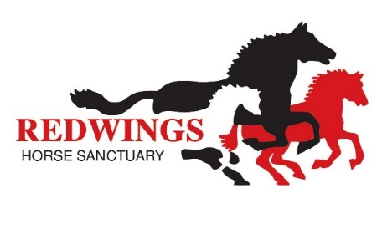
Editable slides for client evenings on strangles and biosecurity
There is a reference slide at the end for further information and context
Feel free to adapt, copy and paste items to personalise, or use as it is!
We do ask that you reference Redwings and retain the Stamp Out Strangles logo
Please signpost people to the Strangles Hub at www.redwings.co.uk/strangles
Encourage your clients to take the Stamp Out Strangles pledge!

Slide 2
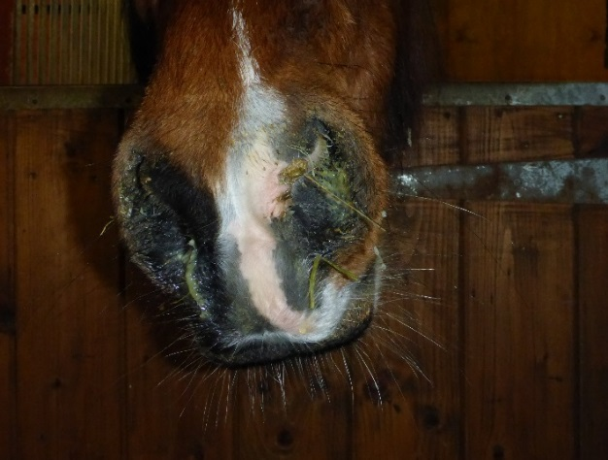
Strangles - staying a step ahead
Tips on disease prevention for horse owners, yard managers and equestrian professionals
Notes:
Welcome and thank you for recognising the importance of updating yourselves on this common infection. It could be easy to become complacent about strangles, after all it’s been around a very long time (evidence from the middle ages!), but in the last couple of decades knowledge about the disease meant we know so much more that can help us reduce risk of infection; lessen the suffering of individual horses and ensure fewer yards and events are cancelled due to outbreak scares.

Slide 3
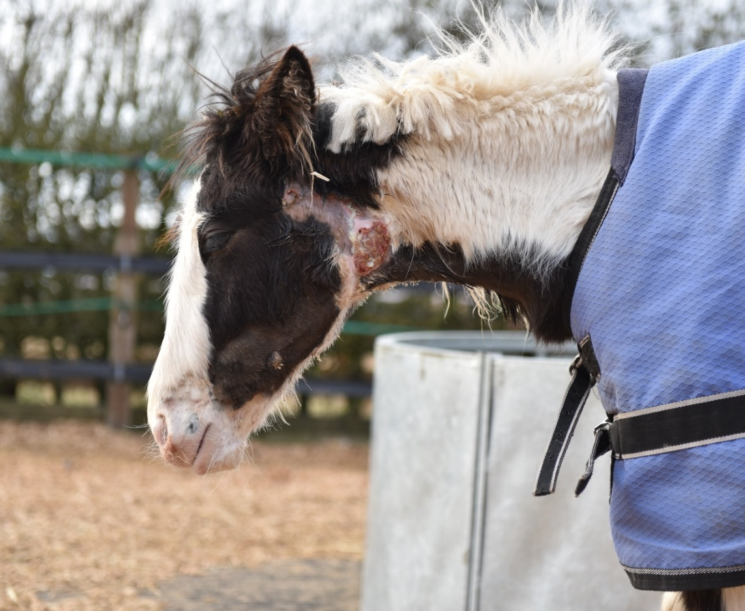
“…an increased understanding of key aspects of disease transmission and improved diagnostics permit the implementation of basic management practices that can virtually eliminate the risk of this disease.”
Dr. Andrew Waller, Animal Health Trust (2011)
Notes:
Dr Andrew Waller
The photo is a foal called Dancer who was part of a group of horses rescued by Redwings and brought into the charity’s quarantine yard in November 2015. Several of the horses tested positive for strangles and Dancer developed the disease shortly after her arrival. Her case was atypical in that she developed multiple small abscesses around her head and neck. Dancer required intensive veterinary and nursing care, but survived. There is a photo of her with her mother taken a few months later on one of our sanctuary sites at the end of the presentation.

Slide 4
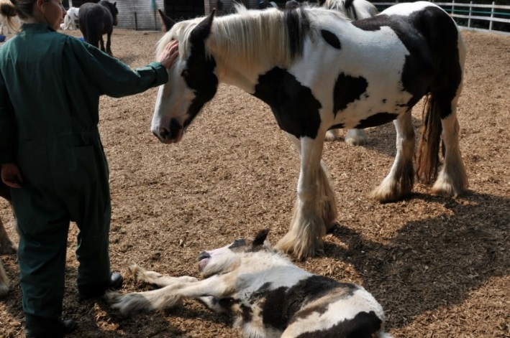
Strangles – why does it matter?
Up to 100% infection rate in horses with no immunity
Most commonly diagnosed infectious disease worldwide (except Iceland!)
600 recorded UK outbreaks every year on average
Causes real suffering and complications (in up to 20% of cases)
Around 1 in 10 horses who recover become carriers
Does not discriminate - moves across the world with mobile equine population
Yet it is eradicable!
Research shows horse owners want to raise standards
Wider benefits for yard management and horse health
Norma was sadly put to sleep after strangles complications led to an abscess bursting into her oesophagus. Though rare, strangles fatalities can be devastating
Notes:
To put the disease in context…
Overarching dilemma is that its widespread, causes suffering (sometimes extreme), all horses are susceptible and carrier status means it doesn’t discriminate –
not a disease of welfare (HRH Princess Anne and 5* event yards to local riding stables) Yet the knowledge and capability to eradicate the disease has never been better!
Iceland is strangles free and horse imports are prohibited to help keep it that way!
600 outbreaks figure is from Animal Health Trust data. Fact that this is only recorded outbreaks suggests real number is likely to be much higher
Wider benefits apply to other infectious diseases, prevention of spread of ringworm and parasite control.
Redwings strangles survey in 2016 revealed that 80% of horse owners would be likely or very likely to want to choose a yard that screened new horses for strangles, although only 13% reported that their current yard had a screening policy in place

Slide 5
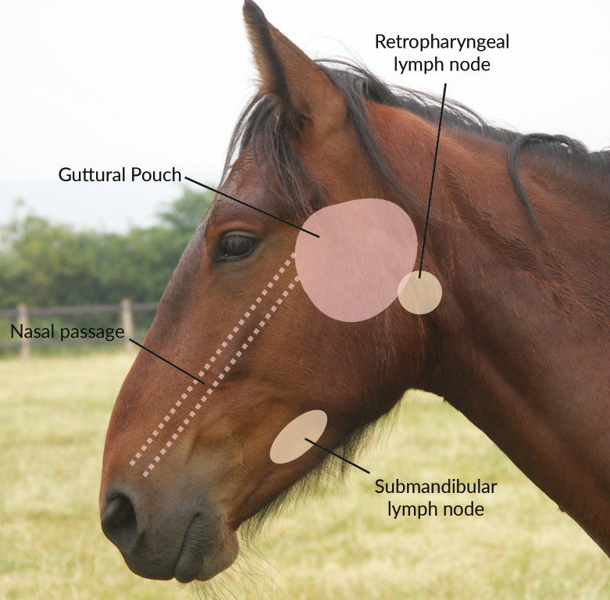
About strangles
Bacterial infection of the upper respiratory tract (Streptococcus equi)
Spreads by direct (horse to horse) and indirect contact (via shared living areas, equipment, tack, transport, water sources and on people’s hands, clothes and feet)
Over 200 strains – make it possible to re-infect (and means vaccine development is tricky!)
Resists the immune system
Can persist in the external environment
Low mortality but high morbidity
Equine specific – does not spread to other species
Complications in up to 20% of cases – usually life-threatening such as ‘Purpura haemorrhaghica’ and ‘Bastard strangles’
Notes:
Redwings strangles survey found that 37% of owners believe strangles can spread on the air, which undermines people’s faith in biosecurity procedures. Making it clear that the bacteria can only be passed by contact helps promote the effectiveness of biosecurity
The bacteria cause an upper respiratory tract infection – just the head and neck areas affected in straightforward cases. Disease process involves bacteria being inhaled or ingested, attaching to the lingual and palatine tonsils and then translocating to deeper tissues before entering the submandibular and retropharyngeal lymph nodes
Because it is so highly contagious and has the ability to spread rapidly through a population
The bacteria is called Streptococcus equi var equi and there are actually about 240 different strains of the bacteria. Many strains has pros and cons - enables the initial cause of an outbreak to be identified but also means that immunity built against one strain does not necessarily protect the horse from future episodes of disease.
it is a complicated bacteria with specific characteristics that make the disease process it causes unique. These features are also what helps researchers to be able to correctly identify it when we send samples for testing. - Identifying features – aerobic, gram positive, beta haemolytic, lancefield group C.
Capsulation helps the bacteria evade the horses immune system assisting its ability to cause disease.
It is specific to equines – so only horses, ponies, donkeys and mules can be infected by it and it can only replicate and multiply within the host.

Slide 6
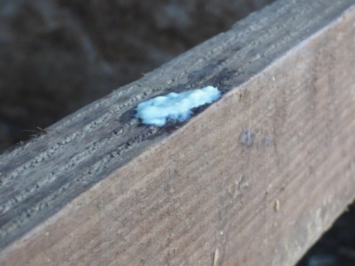

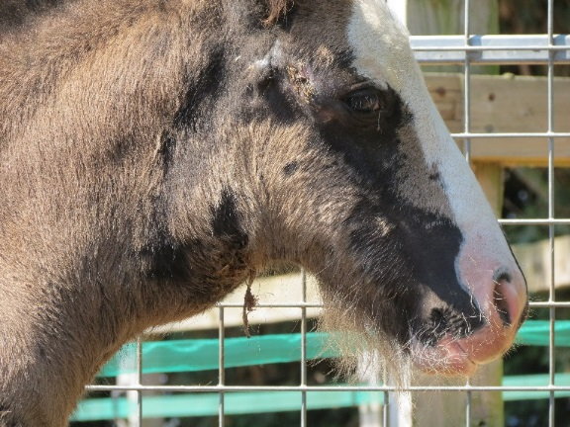
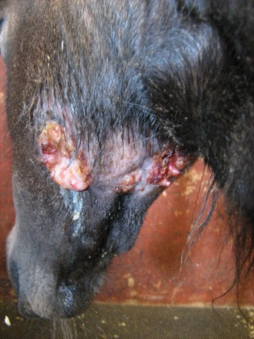
Suffering from strangles
Clinical signs:
Sudden fever
– usually 2-3 days before horse is infectious!
Depression
Anorexia (not eating)
Dysphagia (inability to swallow)
Swollen/abscessed lymph nodes
Dyspnoea (labored breathing)
Profuse purulent (pussy) discharge
Asphyxia (suffocation)
Notes:
Signs of strangles are usually pretty dramatic and the severity of the disease varies greatly depending on immune status.
Acute onset of fever 3- 4 days after exposure followed by depression, anorexia, swelling and abscessation of lymph nodes in the head, labored breathing and problems swallowing linked to the developing abscesses.
Strangles so called because swollen lymph nodes have been known to asphyxiate a horse. Although rare to be fatal in this way, is very important to nurse carefully to monitor breathing and encourage feeding
Pus is difficult to clean – thick, takes time for disinfectant to penetrate, can be hard to spot in environment.
Nasal shedding generally occurs and persists for 2-3 weeks – most of this pus is from abscesses that burst into the pharynx, in other words into the guttural pouches and then into the pharynx and down the nasal passage

Slide 7
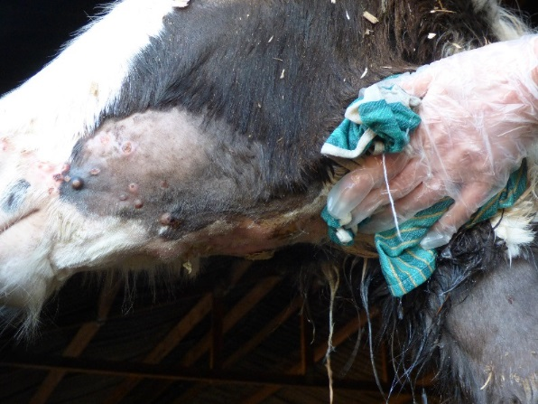
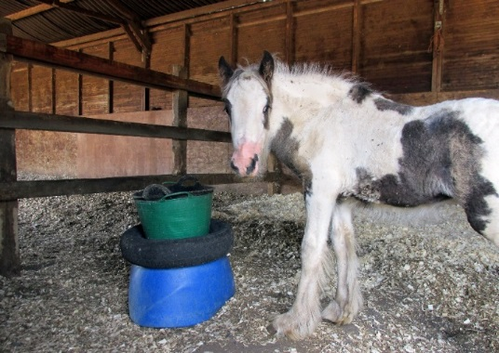
Nursing a horse with strangles
Compassionate nursing - abscess care, pain medication (possibly antibiotics)
Clean abscesses (use a bowl to collect contaminated water/cotton wool used for bathing & soak in disinfectant)
Monitor for deterioration and complications
Keep nursing supplies in the quarantine area.
Usually stabled – horse benefits from:
  Spacious stable
  Full, deep bed
  Good ventilation (disease is not airborne)
  Plentiful fresh water in an easily cleanable container
  Raised food bowl
  Enrichment – sight of other horses and stimulation
Notes:
Strangles patients benefit enormously from compassionate nursing care alongside clinical treatment.
Good biosecurity should give owners confidence to actively care for and monitor their horse… we will come on to that soon.
Message is to remember about welfare when isolating sick horses, whether mirrors or companions in view if horse.
Enrichment is also important once the horse is starting to feel better as they are likely to be infectious for several weeks after they have recovered from symptoms, meaning they should remain in quarantine until they have tested clear.

Slide 8

Strangles progression
Healthy Horse
(susceptible)
Incubation
3 -21 days
Signs
3-8 weeks
Healthy Horse?
Contact with strangles bacteria
Fever
2-3 days before infectious
Non-carrier infectious for 4-8 weeks)
Carrier remains infectious & able to shed for months/years
Notes:
The disease process is the subject of ongoing research (latest veterinary advice published this year with updated info: 2018 consensus statement – see reference slide) but we know that a horse will go through a period of incubation before showing signs of disease and then either developing complications (20%) or recovering with some level of immunity (to that strain) but may be susceptible to others
Incubation length is important for determining how long is needed to quarantine as a precaution against spread of disease. In this time any infected horses should have begun to show signs. Healthy horses go through a slightly longer incubation period than immuno-compromised horses –this can be as long as 21 days so the previous advice of 14 day quarantine is no longer advisable.
Like many illnesses affecting humans; horses with strangles can be infectious to other horse before and after clinical signs have developed which is why we can’t rely on signs of illness to prevent outbreaks spreading
A recovered horse can be a source of infection for up to 6 weeks after clinical signs have resolved. In rare cases patients can persistently shed for much longer.
Without treatment, on average 10 % of infected horses will become carriers. They continue to harbour infection for months or years
The first ‘sign’ of strangles is fever (as mentioned on the previous slide) the latest research reports that the horse is infectious 2-3 days following the onset of fever. By taking rectal temperatures regularly, especially after mixing with unknown horses, and put into precautionary quarantine to prevent contact and sharing of equipment, it’s possible to catch a strangles case early and prevent spread of disease.

Slide 9
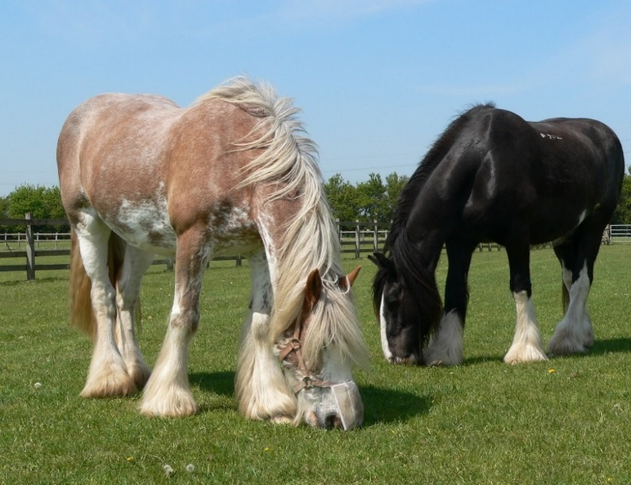
What is a strangles carrier?
Guttural pouch pus
Poor drainage
Chondroid formation – solidifies into ‘cheesy balls’
Horse appears healthy
Increased risk of shedding during times of stress
Horse may produce antibodies indefinitely that will show up on a blood test (some cases do not)
Clydesdale Rosie had been in the same home for 10 years. Routine screening at Redwings found she was a strangles carrier. She was treated and tested negative before being released from quarantine.
Notes:
Rosie would have been considered low risk horse. Only routine screening that involved testing for strangles could have identified her. Redwings has had a protocol for the screening and identification of strangles as part of our routine quarantine of new arrivals since 1991
Sub-clinical carriers, like Rosie, are a regular source of infection. A horse usually becomes a carrier because pus in the guttural pouches (from abscesses on the retropharyngeal lymph nodes) cannot drain easily. As the pus dries out it creates chondroids which harbour bacteria and can shed the disease down the horse’s nasal passages.
Carrier detection is increasingly recognised as an important part of screening new arrivals on yards

Slide 10
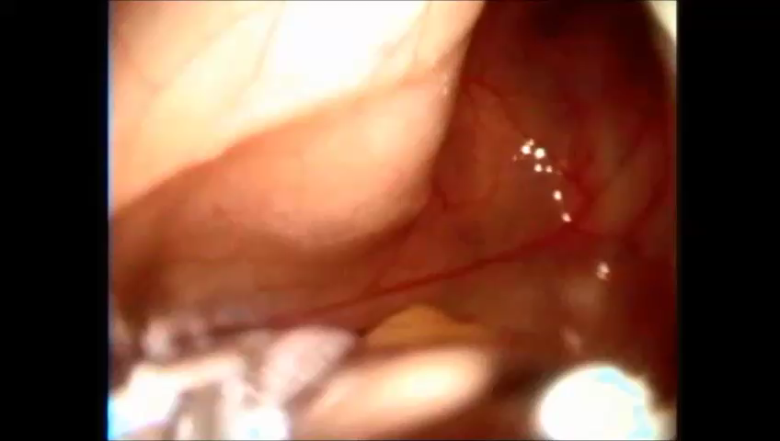
What is a strangles carrier?
Notes:
Film footage showing chondroids removal using an endoscopic memory wire basket. Physical removal of chondroids as the source of infection, followed by flushing the pouch and then subsequent retesting to ensure the horse is now infection-free means the horse presents no further risk.
Some horses can have one small chondroids, others may have more than 100. We’ll look at how long it takes to treat a strangles carrier shortly.

Slide 11
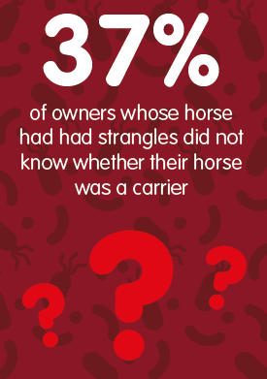
What is a strangles carrier?
  “I owned my pony from three-years-old, competed with him all over the UK and Ireland. I sold him as a nine-year-old and recently found out he was a strangles carrier”
  Data & comment from Redwings’ 2016 strangles survey
Notes:
Carriers are believed to be a key reason that strangles remains endemic in the UK. Ensuring horses who go through the disease are routinely tested after their recovery and treated if they are found to be developing chondroids is absolutely key to tackling the spread of the disease.

Slide 12
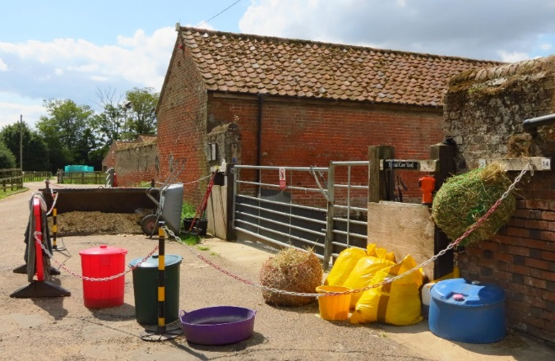
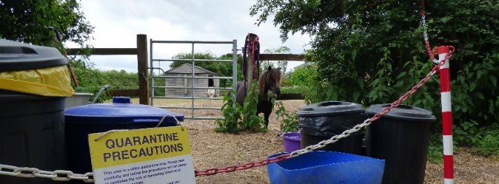
Isolation set-up checklist
Barriers and signs (allow a margin of at least 10 feet between the horse and the boundary or use solid partition such as a wall)
Disinfectant that is effective against strangles (check toxicity to humans, animals and the environment)
Bucket, measuring jug, sprayer and suitable containers for dips
Full length overalls that will cover sleeves, collars and trouser bottoms (re-useable or disposable) and clean bin for storage
Disposable caps (the sort used in food preparation)
Disposable gloves and/or veterinary grade hand sanitiser
Stable tools, handling and nursing equipment including thermometer allocated just to the isolation area
Bin bags (or old plastic feed bags) for storing muck and rubbish
Notes:
Good disease prevention starts with having the basic equipment to be able to isolate / quarantine (explain they are often used interchangeably and generally mean the same thing. We us quarantine internally but isolation or separation may be preferred as long as it doesn’t mislead – horses can be isolated in pairs or as a group.
Isolation or quarantine can be used as a precaution for new arrivals, when a horse returns from an event, if the horse is thought to be ‘at risk’ having possibly been exposed OR, in an outbreak situation where sick horses need to be kept separate from ‘at risk’ and from ‘low risk’
Quarantine is a cornerstone of infectious disease prevention for new arrivals. Isolation alone won’t prevent a carrier coming onto the yard – testing is needed to identify these horses. However, a horse incubating disease should be identified if their health is monitored. Taking rectal temperature daily is key to catching disease at the earliest opportunity.
Short ‘how-to’ films and downloadable resources on setting up and using isolation areas are all available on Redwings Strangles Hub at www.redwings.co.uk/strangles

Slide 13
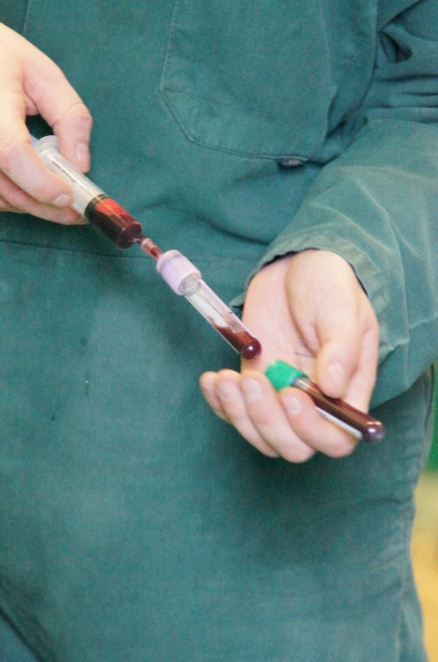
Testing for strangles
Tests are used in two scenarios:
  Routine screening – checking unknown horses who may be strangles carriers, incubating disease or still infectious after recovery
  Outbreak management – to identify infected horses within a population, monitor them and then prevent carriers forming
Four diagnostic approaches:
  Physical examination (only relevant with clinical signs)
  Guttural pouch endoscopy – gold standard diagnosis of carriers - > 99% accurate. Enables a ‘PCR’ lab test to identify genetic material
  Blood test (ELISA) - tests immune response to bacteria (antibodies up to 8 months after exposure and carriers may have raised antibody levels permanently) paired, 2 weeks apart
  Swab – can be used to test nasal discharge or pus from abcesses – least reliable for identifying carriers
Notes:
Quarantine can protect yards from horses who are incubating disease, but to screen for strangles carriers or horses in the recovery phase a test is needed. The same tests are used in an outbreak situation but might need to be interpreted differently to identify infected horses.
Unlike many tests that are conducted primarily to identify what a patient is suffering from, tests for strangles are not only used in sick horses but more commonly on outwardly healthy horses to identify carriers.
Blood tests can tell us if a horse has strangles antibodies circulating in their system. A paired test is commonly used as knowing whether antibody levels are rising, falling or consistent gives us much more information. It can take two weeks for a newly infected horse to begin to produce antibodies, so quarantine is still a key part of the testing process. Depending on blood test results, a horse may require guttural pouch endoscopy to provide a specific answer as to whether the horse is infected or not
Testing – guttural pouch endoscopy is the gold standard – it allows a vet to take samples from directly inside the guttural pouch to be sent away for testing, as well as being able to visually examine the inside of the pouch to check for chondroids, draining abscesses or inflammation.
Research shows nasal swabbing is less accurate – it is also no less intrusive in fact scoping can be preferable for the horse

Slide 14
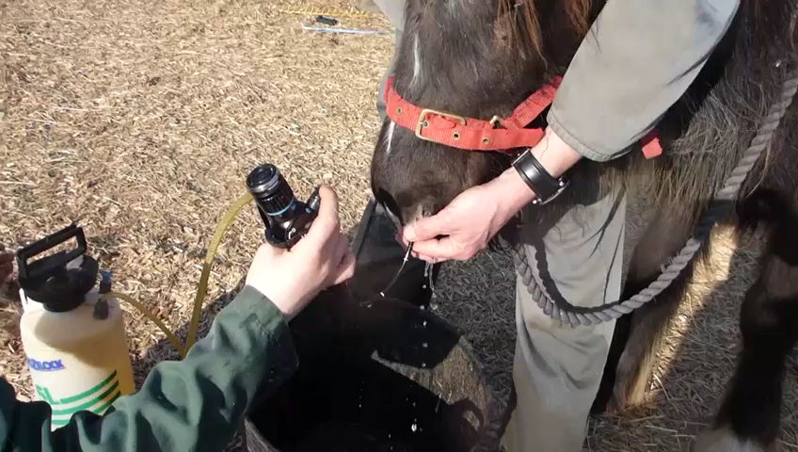
Guttural pouch endoscopy: carrier detection, prevention and treatment
Number of guttural pouch washes required to treat strangles carriers identified on arrival at Redwings between 2011 and 2016 (37 horses in total)
Involve your vet in strangles screening options best suited to your yard.
Notes:
It is possible to prevent strangles from entering premises – although continuous vigilance is required.
Strangles can be eliminated from premises – need to plan and takes effort BUT… outbreaks incentivise this and yards often are motivated in these circumstances.
Promote the benefits of involving vets when yards deciding their screening protocol to talk through pros and cons of the approach and the practicalities in relation to their own facilities and circumstances

Slide 15
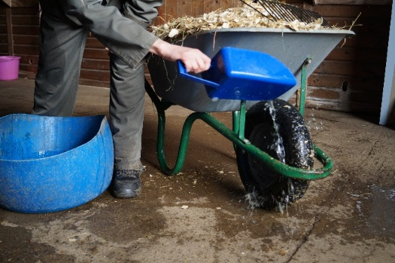
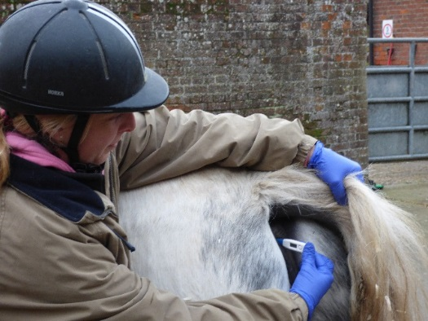
Quick quarantine quiz!
Is strangles airborne?
Can strangles survive outside the horse?
Is it possible to quarantine anywhere other than a stable?
How long should you isolate a new arrival for?
What temperature would indicate fever?
How long can a horse remain infectious for once strangles symptoms have disappeared?
Notes:
This is a common misconception (37% of respondents to Redwings strangles survey believed strangles is airborne) and this could undermine owners motivation to quarantine. But strangles is a disease of contact and much easier to contain than flu
Yes, recent research has found that bacteria may survive just 1-2 days in a hot dry environment but much longer in cool damp conditions and in water. Fields should be unused for at least 2 weeks and water troughs cleaned and disinfected after contact with strangles positive cases
Yes. Preventing nose to nose contact is key in a paddock – use electric tape to create a second line of fencing that creates a buffer zone
Three weeks (two weeks was previously recommended period, but this has been updated to reflect recorded cases of horses taking up to three weeks to show signs of disease after contact with bacteria
A temperature above 38.5º Horse owners who regularly take resting temperature and therefore know their horse’s ‘normal’ are able to spot fever early. It is worth training horses to accept the thermometer (work with someone holding and giving well-timed rewards at the head) is useful for safe working around the rear end of the horse
Up to eight weeks. It can be tempting to release a horse from quarantine because he looks well, without realising the risk. Testing is the best way to be sure a horse is no longer infectious.

Slide 16
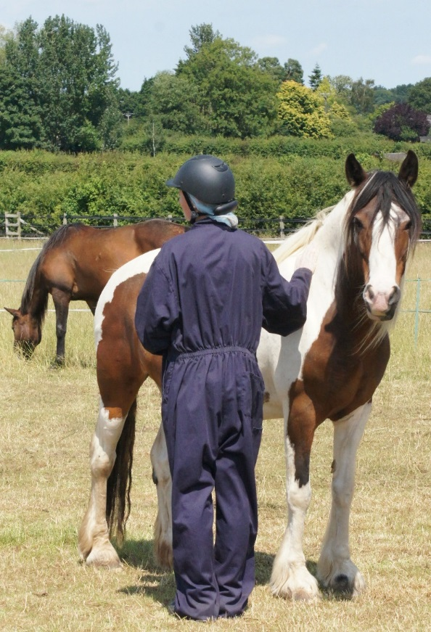
No guarantees!
  No biosecurity system will be 100%
  – outbreaks can still happen
  BUT screening also supports resolution of an outbreak:
  More information on horses’ health history
  Confidence in lack of carriers on site
  Familiarity with setting up and using quarantine
  Knowledge of testing and monitoring for strangles

Slide 17

Notes:
A two-minute film showing how Redwings successfully managed its only strangles outbreak in 23 years of operating a screening programme – during which time it has brought many hundreds of rescued horses into its care from all over the UK
As the film shows, although Redwings have a gold standard screening programme for all new horses, they didn’t assume a horse with signs of infectious disease could not have strangles – no system can be 100% effective

Slide 18
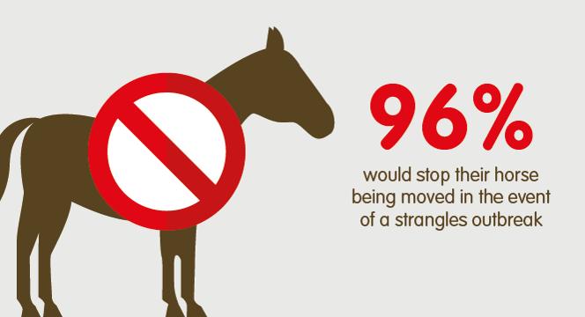
Lessons in outbreak management
Redwings contained its outbreak through:
Quick recognition of signs (even with screening in place)
Immediate isolation stop horse movement before diagnosis
Containment focused
Having diary records of horse movements on and off site
Good communication:
  Co-ordinated veterinary advice
  Regular yard updates – horse owning and non-horse owning public
  Clear signs and visitor info
  Staff training (protect horses elsewhere too)
Screen all relevant horses before lifting quarantine to prevent carriers developing
Redwings Horse Sanctuary (2017) Redwings Strangles Survey Results
Notes:
Redwings wants to share its own experience of outbreak management to show that it can happen to anyone, but by being aware and acting promptly, an outbreak can be quickly and effectively contained and dealt with.

Slide 19
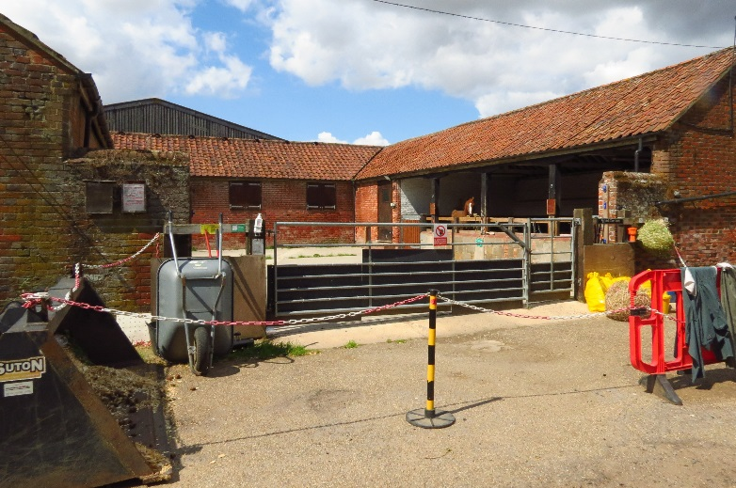
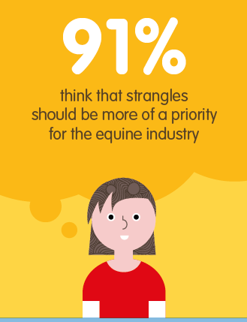
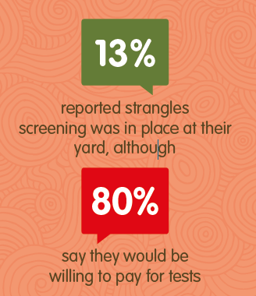
Screening and quarantine is in demand!
Redwings strangles survey found that:
70% of owners are able to quarantine their horse if they want or need to
There is limited sharing of equipment – especially tack
Lack of knowledge and stigma were seen as greater barriers to strangles prevention than cost
Notes:
Redwings strangles survey was run in 2016 and completed by more than 2,000 horse owners across the UK. The results show that people do worry about strangles and want to do more to protect horses from it.
It also showed that the desire for change isn’t yet reflected in the norms we see in the equestrian community. The Stamp Out Strangles campaign wants to galavanise the intention to do more to tackle strangles, give people information and practical ideas, and encourage them to work with their vet – who will be able to show them that protecting horses is probably easier than they think!

Slide 20
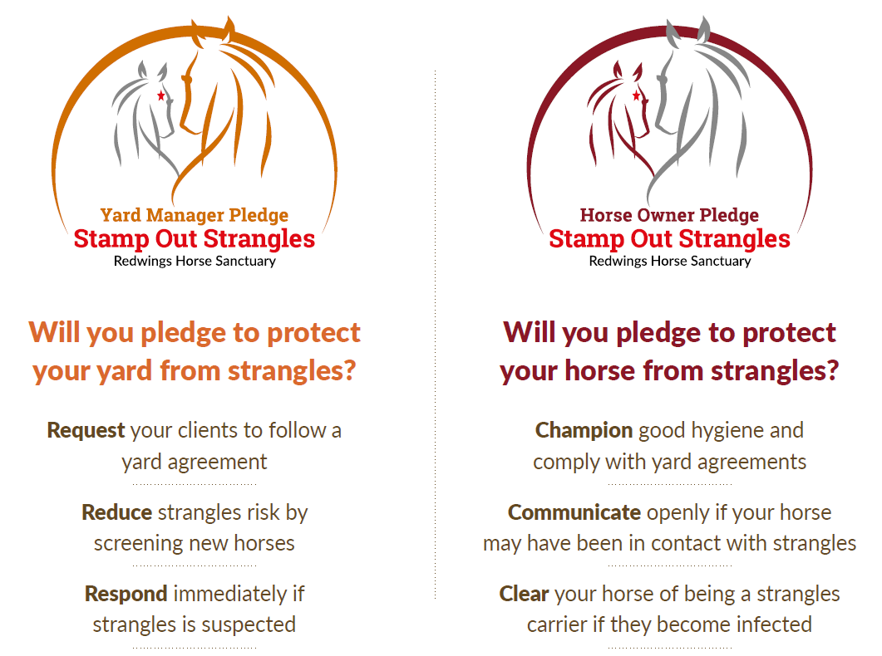
The Stamp Out Strangles pledge
Notes:
Redwings has developed the Stamp Out Strangles pledge to help yard managers and horse owners take a practical, proactive approach to protecting themselves, their horses and their businesses from the disease.
Pledgers will receive regular e-alerts to share the latest information and top tips on strangles prevention to keep the topic in people’s minds and translated into practical action that can really make a difference

Slide 21
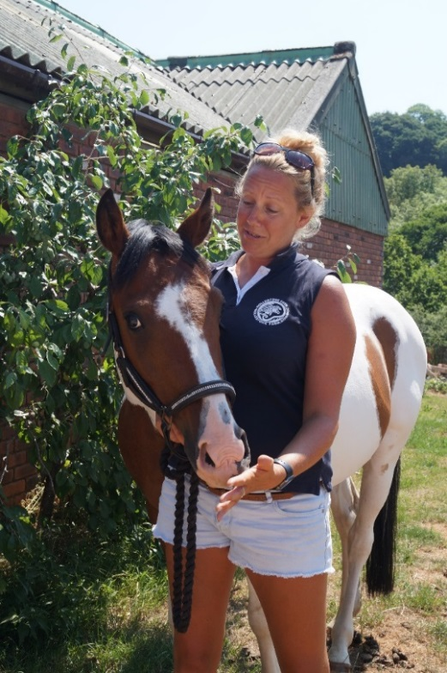
Yards are staying a step ahead
“We are one of the biggest yards in the area, with 50 horses here at any one time, so the logistics of an outbreak would be dire, not to mention the huge veterinary costs involved, and the lockdown meaning no competitions, fun rides, hacking or clinics to aim for and enjoy.
We introduced a quarantine and blood screening policy that we have now had in place for two and a half years
We have not found this impacts at all on our business, other than in a positive way, as our liveries appreciate the efforts taken to help keep their horses safe from strangles.”
Sarah, Livery Yard Manager, Exeter
Notes:
Sarah has taken the Stamp Out Strangles Yard Manager pledge. The yard has well-established screening and biosecurity practices of a high standard and demonstrate how taking a proactive approach is not only possible and practical for a successful business, but actually enhances their reputation and sets standards in the local area.

Slide 22
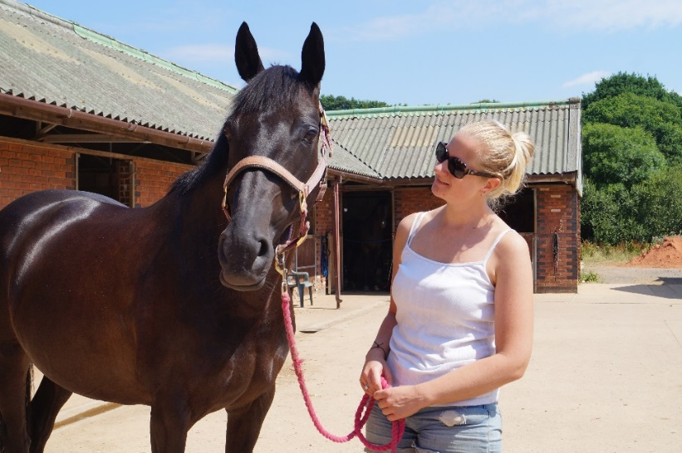
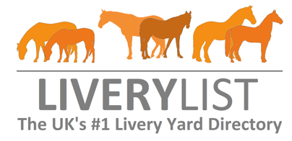
Why wait for an outbreak?
“There is increased demand from horse owners for yards and their staff to have an active part in ensuring the health and welfare of their horses. It is encouraging to see so many yards insisting on isolation and screening for new arrivals, giving horse owners confidence that prevention or an outbreak will be managed well and openly communicated.”
Cheryl Johns,
Company Director, Livery List
“If I were to leave and look at other yards, one of the first questions I would ask would be what their strangles quarantine procedure is”
Jemima, Horse Owner, Exeter
Notes:
Jemima is a horse owner who uses the livery yard managed by Sarah (previous slide). It is vital that yard managers and horse owners work together to make disease-prevention strategies effective. The equal importance of these two roles is reflected in the Stamp Out Strangles pledge

Slide 23
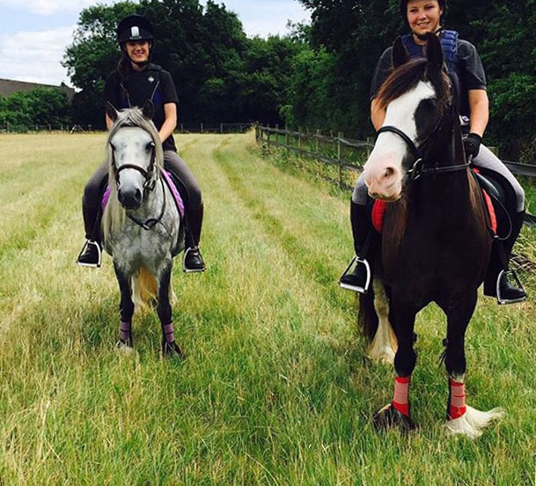
What next…?
Don’t wait for an outbreak – be proactive!
Ask your vet about screening and biosecurity
Take the Stamp Out Strangles pledge and benefit from regular campaign updates and top tips
Keep disinfectant and isolation equipment in stock
Monitor your horse’s temperature
Be open and supportive if an outbreak occurs
Find out more at www.redwings.org.uk/strangles
Spread the word – not the disease!

Slide 24
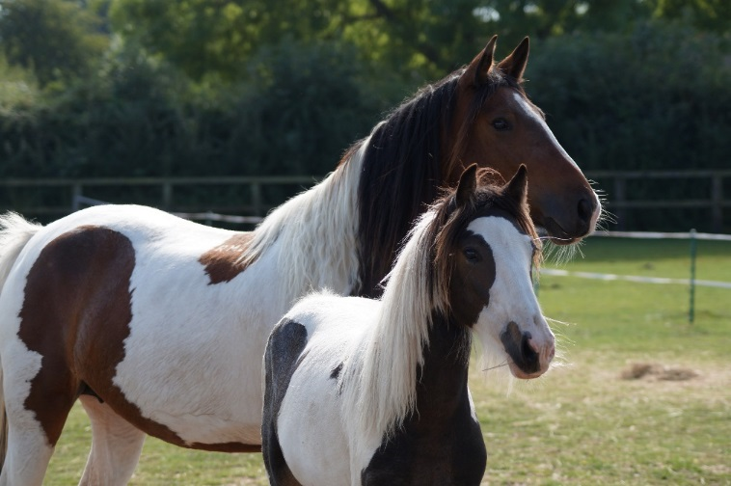
Thanks for listening
Any questions?
Notes:
This is a picture of Dancer, the foal in the first slide (with Andrew Waller’s quote) after recovery from severe strangles. Her mother also tested positive on arrival at Redwings, but was in the recovery phase of the disease

Slide 25
References
Strangles: Speak Out 2nd ed. (2018) www.redwings.org.uk/strangles
Redwings Horse Sanctuary (2017) Redwings Strangles Survey Results: Main report exploring horse-owner knowledge, attitudes and practices around the prevention of strangles
Redwings Horse Sanctuary (2016) Treatment protocol for strangles carriers
A.G. Boyle , J.F. Timoney, J.R. Newton, M.T. Hines, A.S. Waller, and B.R. Buchanan. Streptococcus equi Infections in Horses: Guidelines for Treatment, Control, and Prevention of Strangles—Revised Consensus Statement. Journal of Veterinary Internal Medicine 2018
https://www.vettimes.co.uk/article/strangles-eradication-hopes/?format=pdf
Robinson C et al. Strangvac: A recombinant fusion protein vaccine that protects against strangles, caused by Streptococcus equi. Vaccine (2018), https://doi.org/10.1016/j.vaccine.2018.01.030
Waller, AS.(2016) Strangles: a pathogenic legacy of the war horse Veterinary Record 178, 91-92
AHT/BEVA/DEFRA Equine Quarterly Disease Surveillance Report vol.13, No.4 Oct-Dec 2017
Durham et al (2018) A study of the environmental survival of Streptococcus equi subspecies equi. Equine Veterinary Journal 03.03.18

