Slide 1
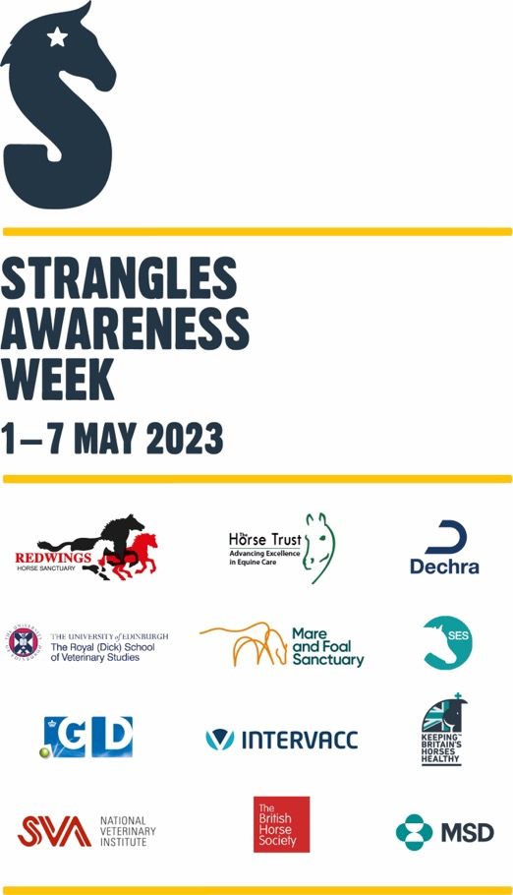
Client event slides on Strangles and biosecurity
Thank you for raising awareness of Strangles!
These slides are editable for your own needs but we ask that you retain the Strangles Awareness Week references and logo, as well as adding your own logo of course.
Please tag @StranglesAwarenessWeek when promoting on social media so we can track and support Strangles client events.
The following slide introducing Strangles Awareness Week can be used purely for your own information or included in the presentation where it suits you.
There is a reference slide at the end for further information and context around Strangles research and resources.
V.3 last updated January 2023

Slide 2

What is STRANGLES AWARENESS WEEK?
The aim of the week, which runs from 1st to 7th May, is to inspire collective action against Strangles. During this week horse owners, vets, yard managers, and members of the equine community do what they can to raise awareness and improve biosecurity to prevent Strangles.
Let’s inspire equestrians to take biosecurity seriously, become Ambassadors and share their own Strangles prevention messages.
There is one simple ask of horse owners: take the Strangles Awareness Week #TempCheckChallenge. This means uploading resting temperatures to learn their horse’s normal, make it routine, and be able to spot fever.
Notes:
Before we start, a bit about Strangles Awareness Week

Slide 3

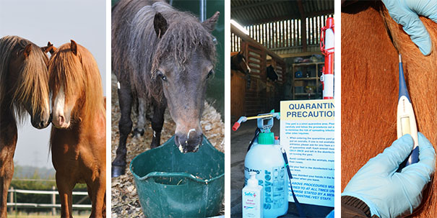
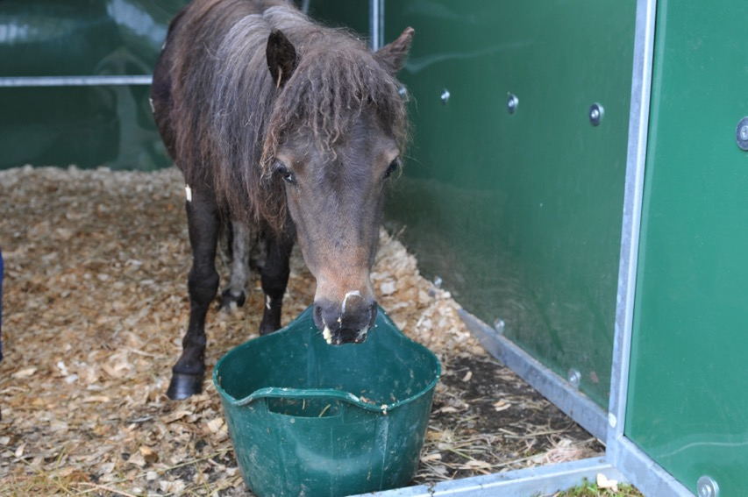
Staying a step ahead of Strangles
Photo credits: Redwings Horse Sanctuary
Photo credits: Redwings Horse Sanctuary
Notes:
Welcome and thank you for recognising the importance of updating yourselves on this common infection.
It could be easy to become complacent about Strangles, after all it’s been around a very long time (evidence of the disease dates to the middle ages!), but in the last couple of decades increased knowledge about the disease means we know so much more that helps us to reduce the risk of infection; lessen the suffering of individual horses and ensure fewer yards and events are cancelled due to outbreak scares.

Slide 4

Presentation outline:
Part 1: What is Strangles and why does it matter?
Part 2: Spotting and diagnosing Strangles
Part 3: Managing an outbreak
Part 4: Reducing the risk

Slide 5
Part 1: What is Strangles and why does it matter?
Part 2: Spotting and diagnosing Strangles
Part 3: Managing an outbreak
Part 4: Reducing the risk

Slide 6
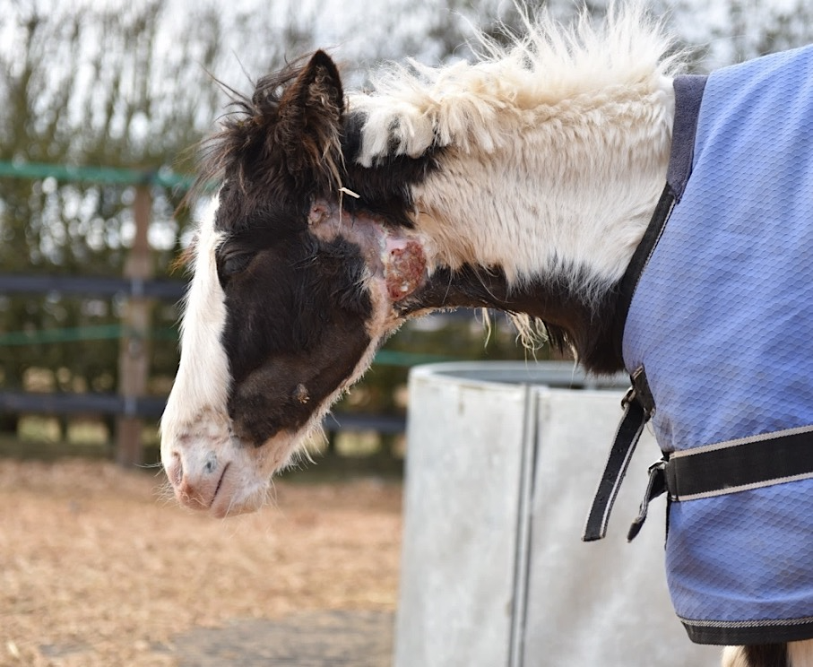
“…an increased understanding of key aspects of disease transmission and improved diagnostics permit the implementation of basic management practices that can greatly reduce the risk of this disease.”
Dr. Andrew Waller, Animal Health Trust (2011)
Photo credit: Redwings Horse Sanctuary
Notes:
Dr Andrew Waller from the Animal Health Trust quotes…. *read off slide**
The photo is a foal called Dancer who was part of a group of horses rescued by Redwings and brought into the charity’s quarantine yard in November 2015. Several of the horses tested positive for Strangles and Dancer developed the disease shortly after her arrival.
Her case was atypical in that she developed multiple small abscesses around her head and neck.
Dancer required intensive veterinary and nursing care, but survived.
There is a photo of her with her mother taken a few months later on one of our sanctuary sites at the end of the presentation.

Slide 7
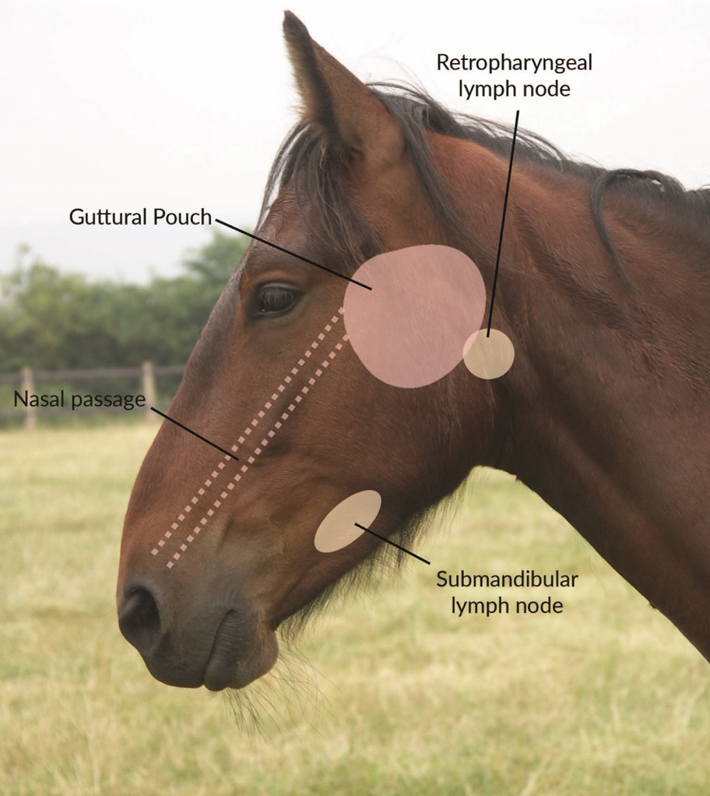

About Strangles
Bacterial infection of the upper respiratory tract (Streptococcus equi)
Equine specific
Spreads by direct and indirect contact
Low mortality but high morbidity
Resists the immune system
Can persist in the external environment – 6 weeks in water
Image credit: Redwings Horse Sanctuary
Notes:
The highly infectious bacteria Streptococcus equi causes an upper respiratory tract infection – just the head and neck areas are affected in straightforward cases.
The disease process involves bacteria being inhaled or ingested, attaching to the lingual and palatine tonsils and then moving to the submandibular and retropharyngeal lymph nodes where it can be detected after only a couple of hours!
It is specific to equines – so only horses, ponies, donkeys and mules can be infected by it.
There are many different types/strains of S. equi, but they can broadly be divided into 6 different groups (https://doi.org/10.1099/mgen.0.000528).
Having many strains has pros and cons - it enables the initial cause of an outbreak to be identified but also means that immunity built against one strain does not necessarily fully protect the horse from future episodes of disease.
Redwings Strangles survey found that 37% of owners believe Strangles is airborne, which undermines people’s faith in biosecurity procedures.
Strangles is not spread in the air – like Equine Influenza which can spread over comparably vast distances. Strangles can be spread by direct contact – horse to horse and by indirect contact with infected shared equipment, living areas, water sources and handlers clothing or hands. It can only be spread in the air as far as a contaminated pus or mucus can be coughed, wiped or transported on people and equipment (fomites).
It is a complicated evolving bacteria with specific characteristics that make the disease process it causes unique.
These features are also what help researchers to be able to correctly identify it when vets send samples for testing.
Identifying features of the bacteria – aerobic growth, Gram positive, beta haemolytic, Lancefield group C. Capsulation helps the bacteria evade the horse's immune system assisting its ability to cause disease.

Slide 8
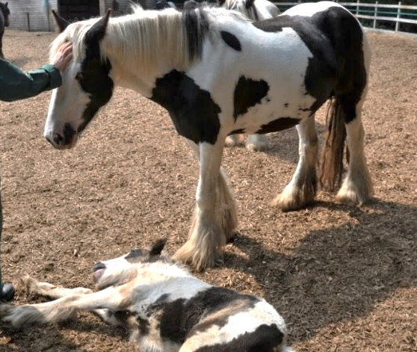
Why does it matter?
Up to 100% infection rate in horses with no immunity
Up to 10% fatality rate in some outbreaks
Does not discriminate – it moves throughout the world with a mobile equine population
Causes real suffering and complications in up to 20% of cases
Approximately 75% of outbreaks result in the development of long term Strangles carriers
Photo credit: Redwings Horse Sanctuary
Norma was sadly put to sleep after complications led to an abscess bursting into her oesophagus.
Though relatively rare, Strangles fatalities can be devastating.
Notes:
To put the disease in context…
The overarching dilemma is that it’s widespread and the most frequently diagnosed infectious disease of horses worldwide. With thanks to the Surveillance of Equine Strangles network’s online platform we can keep a closer look at the number of laboratory diagnoses of strangles and their regional location across the UK. Between January 2022 and December 2022 there were 335 laboratory diagnoses reported to SES across England, Scotland, Wales and Northern Ireland. As these are just figures from laboratory diagnoses, the true number of strangles cases is expected to be much higher!
Strangles causes suffering (sometimes extreme), all horses are susceptible and carrier status means it doesn’t discriminate.
Complications can be seen in up to 20% of cases which are usually life-threatening, such as ‘Purpura haemorrhagica’ and ‘Bastard Strangles’.
Five star event yards, local riding stables and private yards have all been affected, even HRH Princess Anne has had to deal with an outbreak.
Iceland is the only country worldwide that is Strangles free and horse imports are prohibited to help keep it that way!
There are wider benefits to this which apply to other infectious diseases, for example preventing of spread of ringworm and parasite control.
Luckily, the knowledge and capability to eradicate the disease has never been better!

Slide 9
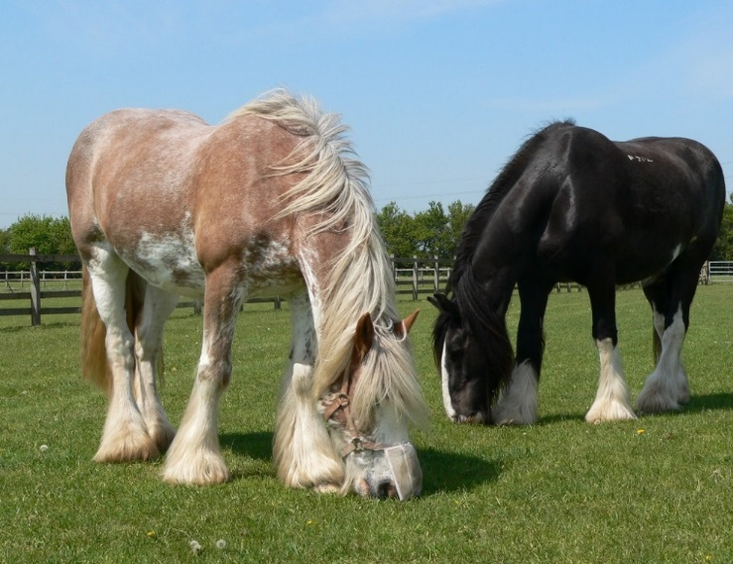
What is a Strangles carrier?
Pus in the guttural pouches during infection
Failure to clear pus from guttural pouches during recovery
Chondroid formation
Pus solidifies into hard ‘cheesy’ balls
Horse appears to have recovered but is actually still infected
Increased risk of shedding during times of stress
Horse may produce antibodies indefinitely that will show up on a blood test (some cases do not)
Photo credit: Redwings Horse Sanctuary
Clydesdale Rosie had been in the same home for 10 years. Routine screening at Redwings found she was a Strangles carrier. She was treated and tested negative before being released from quarantine.
Notes:
Rosie would have been considered a low risk horse.
Only routine screening that involved testing for Strangles identified her as a carrier.
Sub-clinical carriers, like Rosie, are a regular source of infection. A horse usually becomes a carrier because pus in the guttural pouches (from abscesses on the retropharyngeal lymph nodes) cannot drain easily. As the pus dries out it creates chondroids which harbor bacteria and can shed the disease down the horse’s nasal passages.
**CLICK**
Carriers have an increased risk of shedding Strangles bacteria when they are stressed.
Carrier detection is increasingly recognised as an important part of screening new arrivals on yards. Carriers can be identified through blood tests as most will still produce antibodies to the bacteria whilst appearing outwardly healthy.

Slide 10
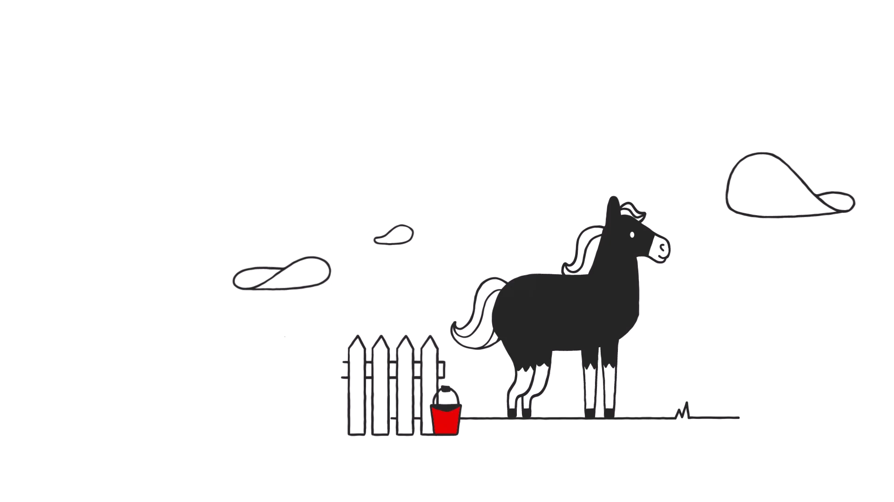
What is a Strangles carrier?
Notes:
**Video auto plays**
Redwings carrier animation 2021
Physical removal of chondroids as the source of infection, followed by flushing the pouch and then subsequent retesting to ensure the horse is now infection-free means the horse presents no further risk.
Some horses can have one small chondroid, others may have more than 100. We’ll look at how long it takes to treat a Strangles carrier shortly.

Slide 11
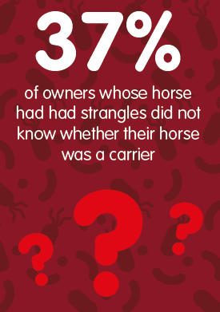
What is a Strangles carrier?
  “I owned my pony from three-years-old, competed with him all over the UK and Ireland. I sold him as a nine-year-old and recently found out he was a Strangles carrier”
  Data & comment from Redwings’ 2016 Strangles survey
Notes:
Carriers are believed to be a key reason that Strangles remains endemic in the UK.
Ensuring horses that go through the disease are routinely tested after their recovery and treated if they are found to be developing chondroids is absolutely key to tackling the spread of the disease.

Slide 12



But there is good news…!
Strangles is potentially eradicable
Research shows horse owners want to raise biosecurity standards
Good biosecurity has wider benefits for yard management and horse health
Notes:
With improved understanding of the disease and appropriate hygiene and biosecurity measures and the identification, treatment and prevention of carriers, Strangles is eradicable. The Stamp Out Strangles pledge includes a commitment to ensure your horse does not become a carrier after infection so the risk of future outbreaks from that infection are eradicated.
Redwings Strangles survey in 2016 revealed that 80% of horse owners would be likely or very likely to want to choose a yard that screened new horses for Strangles, although only 13% reported that their current yard had a screening policy in place.
Improved changes in yard management with regards to Strangles has a positive knock on effect to yard owners and livery clients as well as horse health.

Slide 13
Part 1: What is Strangles and why does it matter?
Part 2: Spotting and diagnosing Strangles
Part 3: Managing an outbreak
Part 4: Reducing the risk

Slide 14
The stages of Strangles
Horse makes contact with Strangles bacteria
Fever usually before horse is infectious
Healthy horse
Healthy horse
(?)
Incubation stage
Clinically ill
(susceptible to infection)
(3-21 days)
(3-8 weeks)
Non-carrier infectious for 4-8 weeks
If unidentified/untreated carrier horses remain infectious and able to shed bacteria for months/years
Notes:
The disease process is the subject of ongoing research (latest veterinary advice with updated info from the 2018 consensus statement – see reference slide) but we know that a horse will go through a period of incubation before showing signs of disease and then either developing complications (20%) or recovering with some level of immunity (to that strain) but may be susceptible to others.
Incubation length is important for determining how long is needed to quarantine as a precaution against spread of disease. In this time any infected horses should have begun to show signs. Healthy horses go through a slightly longer incubation period than immuno-compromised horses –this can be as long as 21 days so the previous advice of 14 day quarantine is no longer advisable. Horses exposed to higher doses of S. equi usually have shorter incubation periods and may develop more severe disease.
Like many illnesses affecting humans, horses with Strangles can be infectious to other horses before and after clinical signs have developed which is why we can’t rely on signs of illness to prevent outbreaks spreading. An apparently recovered horse can be a source of infection for up to 8 weeks after clinical signs have resolved as residual abscess material drains from the guttural pouches. Carriers can persistently shed S. equi for much longer.
Approximately 75% of outbreaks will have horses that become carriers if not appropriately screened and treated post-outbreak. They can continue to harbour infection for months or years. Carriers can be identified through post outbreak screening procedures allowing for additional treatment to free the horse from infection.
The first ‘sign’ of Strangles is fever (as mentioned previously) the latest research reports that the horse is usually infectious 2-3 days following the onset of fever. By taking rectal temperatures regularly, especially after mixing with unknown horses, and putting horses into precautionary quarantine to prevent contact and sharing of equipment, it’s possible to catch a Strangles case early and prevent the spread of disease.
Knowing your own horse’s normal resting temperature is a step you can take today. By knowing your horse’s normal, it will be easier to spot a spike in temperature.

Slide 15
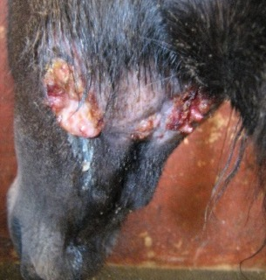
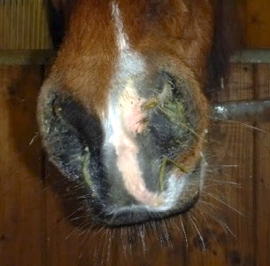
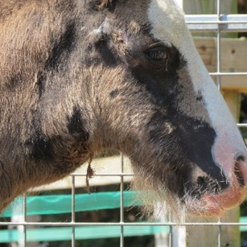
Suffering from Strangles
Sudden fever | Usually just before the horse is infectious
Depression | Looking dull and uninterested
Nasal discharge | Thick, smelly, yellow in appearance
Anorexia | Not eating
Dysphagia | Inability to swallow
Swollen lymph nodes | Painful to touch
Abscesses of the lymph nodes | Pus bursting out through the skin or into the guttural pouches
Dyspnoea | Laboured breathing
Asphyxia | Suffocation due to large swelling of the lymph nodes
Photo credits: Redwings Horse Sanctuary
Notes:
More advanced signs of Strangles can be dramatic and the severity of the disease varies greatly depending on the horse’s immune status.
Clinical signs include, acute onset of fever 3- 4 days after exposure followed by depression, anorexia, swelling and abscessation of lymph nodes in the head, labored breathing and problems swallowing linked to the developing abscesses.
Strangles, so called because swollen lymph nodes have been known to asphyxiate some horses.
Although relatively rare to be fatal in this way, is very important to nurse carefully to monitor breathing and encourage feeding.
Pus is difficult to clean. It is thick, takes time for disinfectant to penetrate and can be hard to spot in the environment.
Nasal discharge generally occurs and persists for 2-3 weeks – most of this pus is from abscesses that burst into the guttural pouches and drain into the pharynx when the horse’s head is lowered and then down the nasal passage.
A 2021 study from the Surveillance of Equine Strangles network reported that abscesses were less frequently noted by vets, the authors suggested this may be because owners are calling their vet in the earlier stages of infection – prior to the development of abscesses which is a good sign that infection is being caught earlier with less chance for transmission.

Slide 16
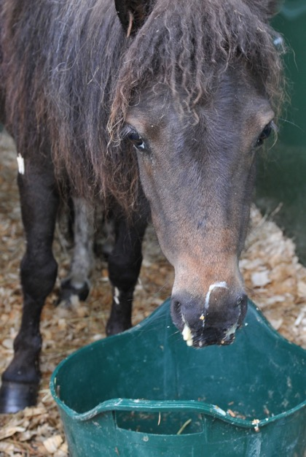
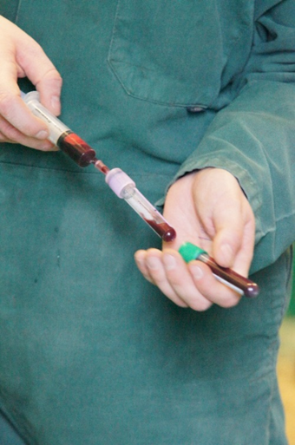
Testing for Strangles
There are two scenarios for Strangles testing:
Outbreak management
Routine screening
Identifying infected horses in a population, monitoring them once clinical signs have ceased and preventing carriers forming
Checking new horses to a yard who may be Strangles carriers, incubating disease or still infectious after recovery
Photo credits: Redwings Horse Sanctuary
Notes:
Quarantine can protect yards from horses who are incubating disease, but screening for Strangles carriers or horses in the recovery phase is still needed.
The same tests are used in an outbreak situation but might need to be interpreted differently to identify infected horses.
Unlike many tests that are conducted primarily to identify what a patient is suffering from, tests for Strangles are not only used in sick horses but more commonly on outwardly healthy horses to identify carriers. Between January 2020 and December 2021 just over one third of horses that had laboratory diagnoses of Strangles were sub-clinical, meaning they showed no symptoms, and were identified through post outbreak screening or the Strangles blood test.

Slide 17
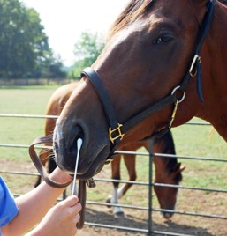
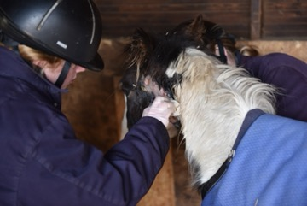
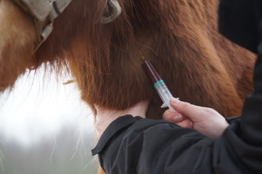
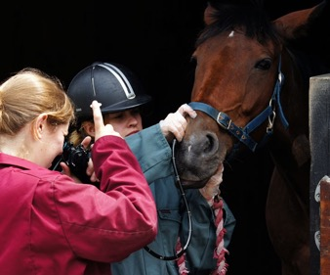

Testing for Strangles
Four diagnostic approaches:
Physical examination Only relevant when horses are displaying clinical signs | Swabs Taken nasopharyngeal, nasal or from an abscess Least reliable for identifying carriers (
Blood test (ELISA) Tests immune response to Strangles Paired samples two weeks apart | Guttural pouch endoscopy Most efficient sampling method for laboratory diagnosis Gold standard for carrier diagnosis
Photo credits: Redwings Horse Sanctuary
Notes:
Physical examination is a good place to start with identifying Strangles, however, without laboratory diagnosis there will be no confirmation that the horse is truly affected by the bacteria that causes Strangles. A few other infectious diseases of horses present with similar clinical signs to Strangles (fever, nasal discharge, depression), so further testing is highly advisable to make sure vets are treating the right disease in the right manner.
Swabs are the easiest sample to take from a horse, whether it’s a nasal swab, a nasopharyngeal swab (which reaches to the back of the horse’s nasal cavity) or a swab of an open abscess. Although swabs are the easiest sample to take they must be used at the correct time during the illness. If a horse is very early on in the disease and not yet shedding bacteria into the nasal cavity, you may end up with a false negative result, as the swab won’t have picked up bacteria. Similarly swabs are the least reliable way to test carriers because carriers intermittently shed bacteria from their guttural pouches, so again, the swab may not collect any bacteria at the time of swabbing.
Guttural pouch endoscopy is considered the gold standard for detecting carrier horses and in post outbreak screening – it allows a vet to take samples from directly inside the guttural pouch to be sent away for testing, as well as being able to visually examine the inside of the pouch to check for chondroids, draining abscesses or inflammation.
Blood tests can tell us if a horse has Strangles antibodies circulating in their system.
During post outbreak screening to confirm a horse is free from Strangles guttural pouch endoscopy is the most efficient approach. If using nasopharyngeal swabs a vet must visit the yard three times, seven days apart, swab the horse each time and each swab must come back negative. If a swab comes back positive the vet should use guttural pouch endoscopy to visually assess the guttural pouches and treat the horse further. Whereas with guttural pouch endoscopy a vet will come and scope the horse and sample directly from the pouches where any residual bacteria may be ‘hiding’. If the sample comes back negative then the horse is declared free from Strangles after that one visit. If it comes back positive then further treatment will be required.
During post outbreak screening guttural pouch endoscopy is also no less intrusive than swabbing and in fact scoping can be preferable for the horse.

Slide 18
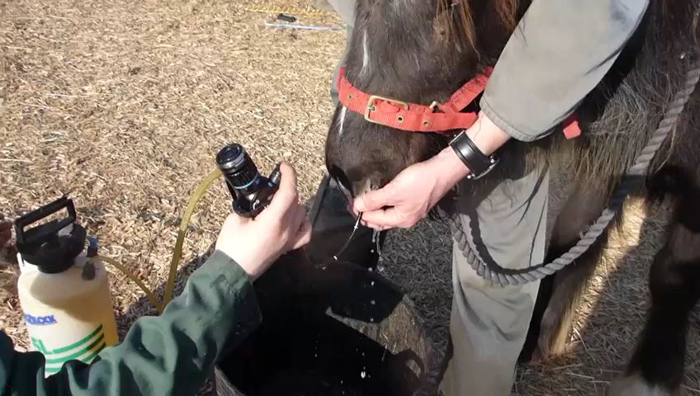
Guttural pouch endoscopy gold standard carrier detection, prevention and treatment
Number of guttural pouch washes required to treat Strangles carriers identified on arrival at Redwings Horse Sanctuary between 2011-2016 (37 horses in total)
Involve your vet when deciding which Strangles screening options are best suited to your yard and clients
Photo credit: Redwings Horse Sanctuary
Notes:
**Video auto plays**
It is possible to prevent Strangles from entering premises through quarantine and screening procedures – and continuous vigilance is required.
If carriers are identified, the good news is, Strangles can be eliminated from a premises. This requires planning and effort and close involvement with your vets but it can be done! It’s often found that once a yard has suffered from an outbreak, they are incentivised to bring in new responsible measures and livery clients become more motivated in these circumstances.
**Promote the benefits of involving vets when yards are deciding their screening protocol to talk through pros and cons of the approach and the practicalities in relation to their own facilities and circumstances**

Slide 19
Blood testing: where, when and why
Up to 100% of horses exposed to S. equi during an outbreak may be ‘seropositive’ (have antibodies against the Strangles bacterium)
Antibody responses decline over time with most horses testing ‘seronegative’ after 8 months
Testing horses that remained healthy at the end of an outbreak can identify those that may have had mild/atypical Strangles that could have become carriers
Serology can be used to confirm the involvement of S. equi in complicated conditions including purpura haemorrhagica and bastard Strangles
The use of serology to identify carriers is less sensitive and specific than guttural pouch endoscopy, but can be a useful tool as long as owners appreciate the limitations
Notes:
The use of blood tests as a screening test for chronic carriers has become commonplace (Waller, 2014).
When used to screen horses with an unknown clinical history two sampling events two weeks apart can be used, this is called paired testing. Paired testing allows us to see whether antibody levels are rising, falling or consistent giving us much more information than results from a single sampling event.
This is because it can take two weeks for a newly infected horse to begin to produce antibodies, so quarantine is still a key part of the testing process.
Depending on blood test results, such as stable high/positive antibody levels or rising antibody levels, a horse may require guttural pouch endoscopy to provide a specific answer as to whether the horse is infected or not.
NEW CONTENT
However, with long term carriers (>10 months after recovery), the blood test appears to become less reliable as not all horses maintain high concentrations of antibodies to S. equi, even if there is persistent infection within the guttural pouches.
While comparing results of ELISA and PCR tests over-simplifies the challenges of detecting carriers that present a risk for transmission of infection, these recent investigations of the dual antigen iELISA in detecting chronic carriers have highlighted the misguided inference of some laboratories and clinicians in definitively confirming the absence of a carrier state based solely on a single or paired negative iELISA result. Identification of carriers is not ‘black and white’, and factors such as how carriers are being defined, clinical and outbreak history, use of antimicrobials, individual response to infection and immunity have to be considered, alongside recognising the potential for genetic variability of carrier strains.
Subject to these limitations, the iELISA remains a useful tool on both a population and single horse basis albeit that it may miss some long-term carriers (Pringle et al, 2020). It would be preferable for all potential carriers to be examined by guttural pouch endoscopy and sampling, but as this is unlikely to happen in practice and the use of serology remains a useful tool as long as limitations are understood by veterinary surgeons and yard owners.

Slide 20
Part 1: What is Strangles and why does it matter?
Part 2: Spotting and diagnosing Strangles
Part 3: Managing an outbreak
Part 4: Reducing the risk

Slide 21
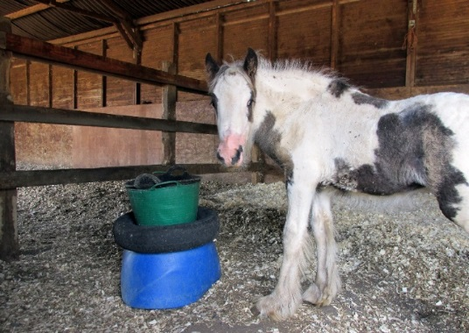
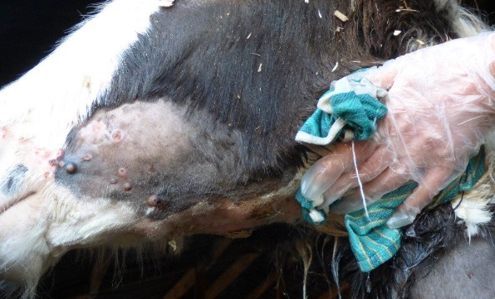
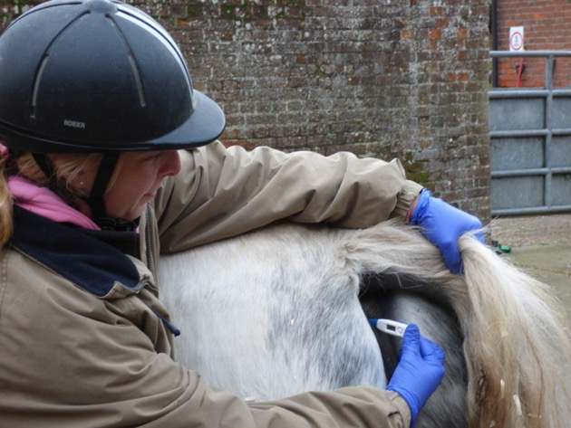
Nursing a horse with Strangles
Compassionate nursing in quarantined area
Keep nursing supplies in the quarantine area
Clean abscesses (use a bowl to collect contaminated water/cotton wool used for bathing & soak in disinfectant)
Monitor closely for deterioration/complications
Photo credits: Redwings Horse Sanctuary
Notes:
Strangles patients benefit enormously from compassionate nursing care alongside clinical treatment whilst they are in quarantine.
Remember to keep all your medical and treatment supplies within the quarantined area.
Treatment includes:
Cleaning of any abscesses, pain medication and possibly antibiotics. In most cases horses will not require antibiotics, and the latest guidelines suggest limiting the use of antibiotics in Strangles cases as they can in fact prolong the course of the infection and prevent the horse from developing antibodies/protection to the bacteria. There is also early evidence of mutations in penicillin binding proteins, suggesting that S. equi may be evolving towards decreased susceptibility.
Whilst nursing the horse, make sure to monitor them closely to quickly pick up on any deterioration and complications that may be arising.
Good biosecurity should give owners confidence to actively care for and monitor their horse… we will come on to that soon.

Slide 22
Nursing a horse with Strangles
Usually stabled horses benefit from:
  Spacious stable
  Full, deep, clean bed
  Good ventilation (disease is not airborne)
  Plentiful fresh water in an easily cleanable container
  Raised food bowl in early stages
  Enrichment – sight of other horses and stimulation
Photo credits: Redwings Horse Sanctuary
Notes:
The main message is to remember horse welfare when isolating sick horses.
If possible, use stable safe mirrors to keep other companions in view of the horse, but they must not able to touch or share equipment or water.
Enrichment is also important once the horse is starting to feel better as they are likely to be infectious for several weeks after they have recovered from symptoms, meaning they should remain in quarantine until they have tested clear.
As horses start to feel better, lower feed sources to the ground to encourage drainage of abscess material and reduce the risk of carrier development.

Slide 23
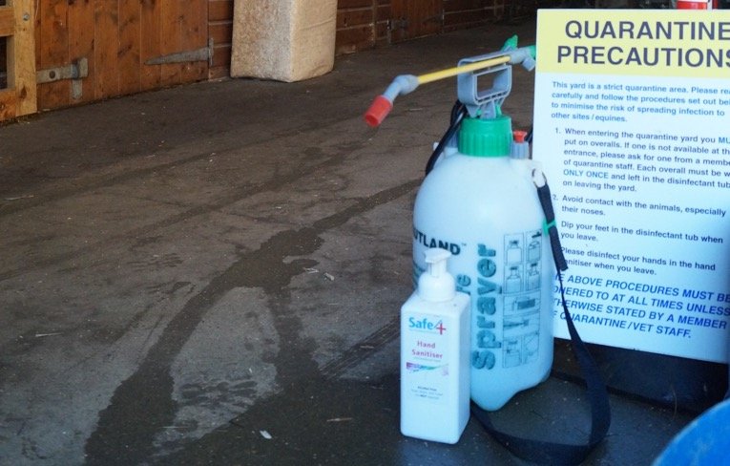
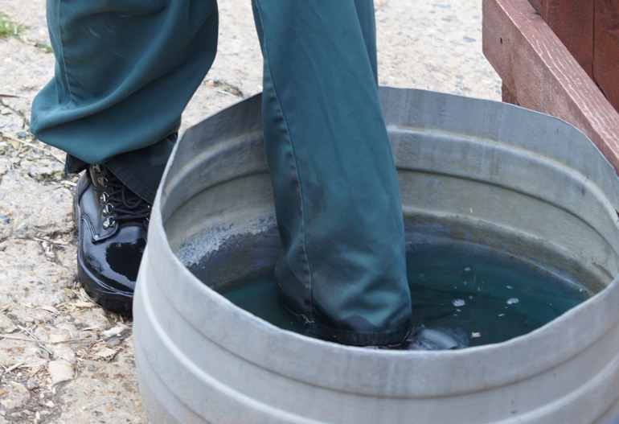
Isolation checklist
Barriers and signs (allow a margin of at least 10 feet between horse and boundary or use solid partition such as a wall)
Disinfectant that is effective against Strangles (check toxicity to humans, animals and the environment)
Bucket, measuring jug, sprayer and suitable containers for dips
Bin bags (or old intact plastic feed bags) for storing muck and rubbish
Photo credits: Redwings Horse Sanctuary
Notes:
Good disease prevention starts with having the basic equipment to be able to isolate / quarantine (explain these terms are often used interchangeably and generally mean the same thing). Horses can be isolated in pairs or as a group.
Isolation or quarantine can be used as a precaution for new arrivals, when a horse returns from an event, if the horse is thought to be ‘at risk’ having possibly been exposed OR, in an outbreak situation where sick horses need to be kept separate from ‘at risk’ and from ‘low risk’
Quarantine is a cornerstone of infectious disease prevention for new arrivals.
Isolation alone won’t prevent a carrier coming onto the yard – screening tests are needed to identify these horses.
However, a horse incubating disease can be identified if their health is monitored correctly for example, taking rectal temperature daily is key to catching disease at the earliest opportunity.
Here we outline the key things needed to create a sufficient isolation space, and it’s important to note that you do not need a stable block to create an isolation space:
Starting with barriers and obvious signage to prevent flow through of traffic of people and horses.
Disinfectant for cleaning equipment and creating a foot dip for people having to go in and out of the isolation area.

Slide 24
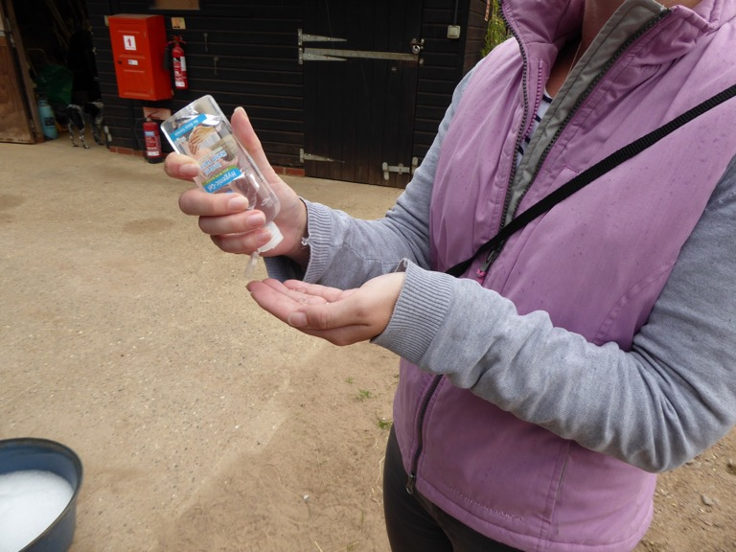
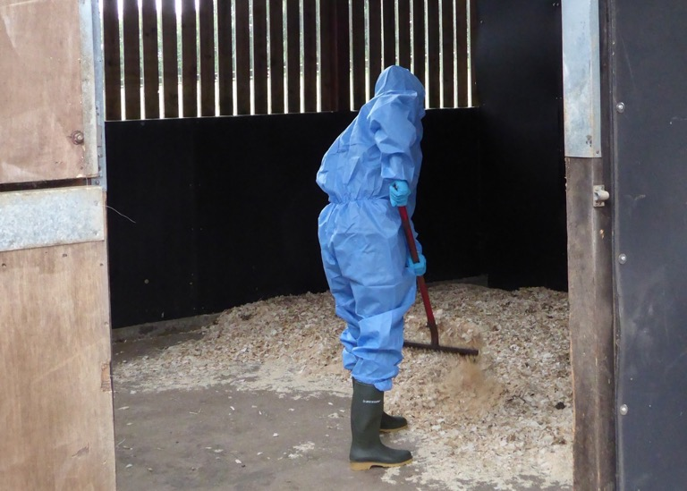
Isolation checklist
Full length overalls that will cover sleeves, collars and trouser bottoms (re-useable or disposable) and clean bin for storage
Disposable caps (the sort used in food preparation)
Disposable gloves and/or veterinary grade hand sanitiser
Stable tools, feed, handling and nursing equipment including thermometer allocated solely to the isolation area
Photo credits: Redwings Horse Sanctuary
Notes:
For people caring for the horses in isolation, ideally disposable coveralls should be used to protect clothing from any infectious material alongside disposable gloves and caps.
Having hand sanitiser available within the isolation space is also key to help preventing the spread of disease. Carers should use hand gel or wash their hands in between caring for each horse in isolation.
If disposable coveralls aren’t available then horses in isolation should be seen after all of the other horses on the yard to prevent the spread of infection to other healthy horses on the yard or a spare change of clothes and shoes can be used as long as carers change and wash their hands before handling other horses and these clothes must be washed as soon as possible.
Finally, within the isolation space you should have dedicated equipment and tools that stay within the isolation space. It’s a good idea to mark equipment with coloured tape to help remind you that this equipment belongs in the isolation space.
You will need rubbish bags as well for storing consumables such as the disposable coveralls and gloves as well as dirty stable bedding.
Dirty stable bedding from isolation should not be put directly on the muck heap due to the potential of spreading infectious material to a ‘shared space’.
Remember to think about the bedding type used in isolation too. Laboratory studies have found that when compared to straw and hemp materials, pine and spruce wood shavings had an inhibitory effect on the growth of S. equi.

Slide 25
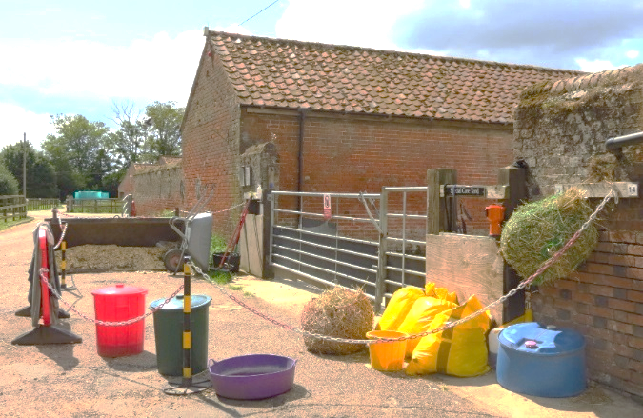
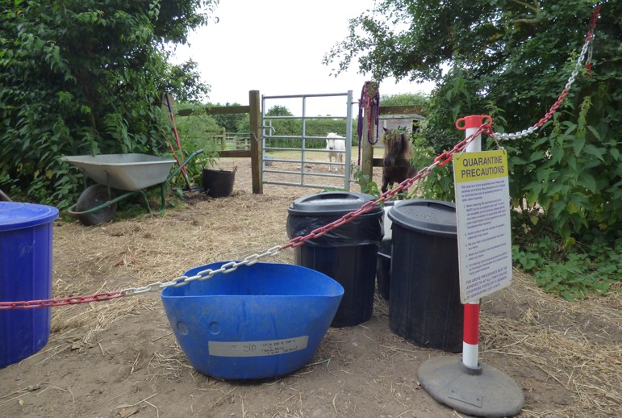
Working together
Strangles can happen to anyone
Being open and honest helps everyone take precautions
Be guided by your vet and ask as many questions as you need to
Keep communicating (positively!) and working as a team
Outbreaks can be stressful, tiring and emotional – support those affected and don’t be afraid to ask for support yourself!
Photo credits: Redwings Horse Sanctuary
Notes:
Strangles doesn’t just affect horses, it can have a big impact on people. Outbreaks often come at a financial, emotional and physical cost.

Slide 26


Quick quarantine quiz!
1. Is Strangles airborne?
Answer: No
2. Can Strangles survive outside the horse?
Answer: Yes
3. Is it possible to quarantine anywhere other than a stable?
Answer: Yes
4. How long should you isolate a new arrival for?
Answer: Three weeks
5. What temperature would indicate fever?
Answer: ≥ 38.5ºC
6. How long can a horse remain infectious for once Strangles symptoms have disappeared?
Answer: Potentially years, if the horse has become a carrier!
Notes:
This is a common misconception (37% of respondents to Redwings Strangles survey believed Strangles is airborne) and this could undermine owners motivation to quarantine. But Strangles is a disease of contact and much easier to contain than flu
Yes, recent research has found that the bacteria may survive just 1-2 days in a hot dry environment but much longer in cool damp conditions and in water. Fields should be unused for at least 2 weeks and water troughs cleaned and disinfected after contact with Strangles positive cases
Yes. Preventing nose to nose contact is key in a paddock – use electric tape to create a second line of fencing that creates a buffer zone
Three weeks (two weeks was previously recommended period, but this has been updated to reflect recorded cases of horses taking up to three weeks to show signs of disease after contact with bacteria
A temperature equal to or above 38.5ºC Horse owners who regularly take resting temperature and therefore know their horse’s ‘normal’ are able to spot fever early. It is worth training horses to accept the thermometer (work with someone holding and giving well-timed rewards at the head) is useful for safe working around the rear end of the horse
Years, if the horse has become a carrier. It can be tempting to release a horse from quarantine because he looks well, without realising the risk. Testing is the best way to be sure a horse is no longer infectious.

Slide 27
Part 1: What is Strangles and why does it matter?
Part 2: Spotting and diagnosing Strangles
Part 3: Managing an outbreak
Part 4: Reducing the risk

Slide 28
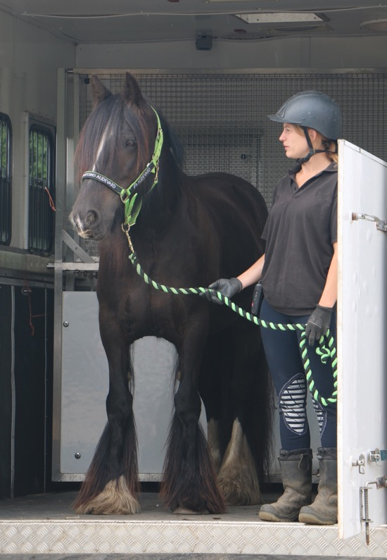


Can we identify ‘risky’ scenarios?
Research from the Royal Veterinary College:
UK horse owner survey (date?)
58% of respondents had a new horse move to their premises in the two weeks before the outbreak began
  17% isolated new arrivals and only 8% tested new horses
67% of respondents said resident horses travelled off the premises and back in the two weeks before the outbreak began
  Only 8% carried out regular temperature checking
Photo credit: Redwings Horse Sanctuary
Notes:
Research undertaken by the Surveillance of Equine Strangles network asked horse and yard owners that had been affected by a strangles outbreak between 2020 and 2022 about potential risk factors occurring in the two weeks before the outbreak.
The two most frequently reported events were a new horse moving to the yard and resident horses travelling off the premises and back (for things such as competitions, hacking or schooling). It can’t be confirmed if either the new horses were the source of the outbreak or if a resident horse was infected off-site, however, these data serve as an important reminder of the value of quarantine and screening protocols for new horses to a premises.
When we look at the premises biosecurity measures in place BEFORE the outbreak began, there were limited measures in place with less than 20% isolating new arrivals and less than 10% screening new arrivals or regularly checking the temperatures of resident horses. AFTER experience a strangles outbreak these figures increase to 39% of respondents isolating new arrivals, 30% screening new arrivals and 22% regularly checking resident horse temperatures.
What can we take away from this? Don’t underestimate the value of isolating and screening new horses for infectious diseases when they arrive, through this action you could stop a strangles outbreak affecting the whole yard and just contain and treat one horse in isolation.
With the high percentage of horses travelling off premises in the two weeks before the outbreak began – one simple measure that can be used to catch the onset of infection early is regular temperature checking – take the SAWtempcheck challenge this year and start a new habit!

Slide 29
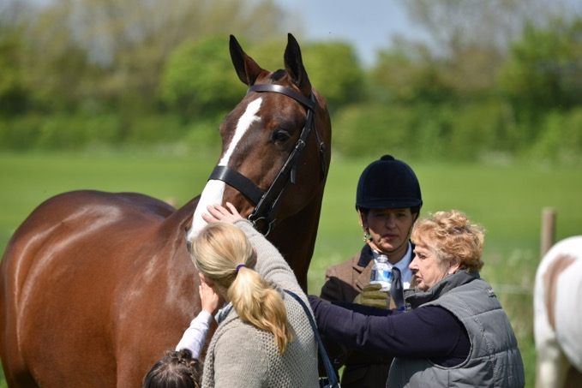
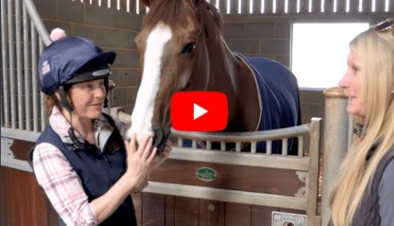
Minimising the risk of Strangles at events
Avoid direct and indirect contact at events
  DON’T permit nose to nose contact
  DON’T share drinking water, feed, tack, etc
  DON’T allow passers-by to touch horses
Monitor horses closely on return from events
  DO take daily temperatures (≥38.5 ºC = danger)
  DO keep returning horses in a separate group(s)
  DO encourage hand washing and good biosecurity
Reduce the risk by vaccination
Photo credits: Redwings Horse Sanctuary
Notes:
The risk of exposure to S. equi can be reduced by minimising the contact that horses have with other horses whilst attending events.
Monitoring horses on their return can catch potential cases early and keeping returning horses in a separate group can minimise the risk of transmission through the whole yard.
The risk of horses that come into contact with S. equi develop Strangles can be reduced by vaccination – ask your vet for further information.

Slide 30
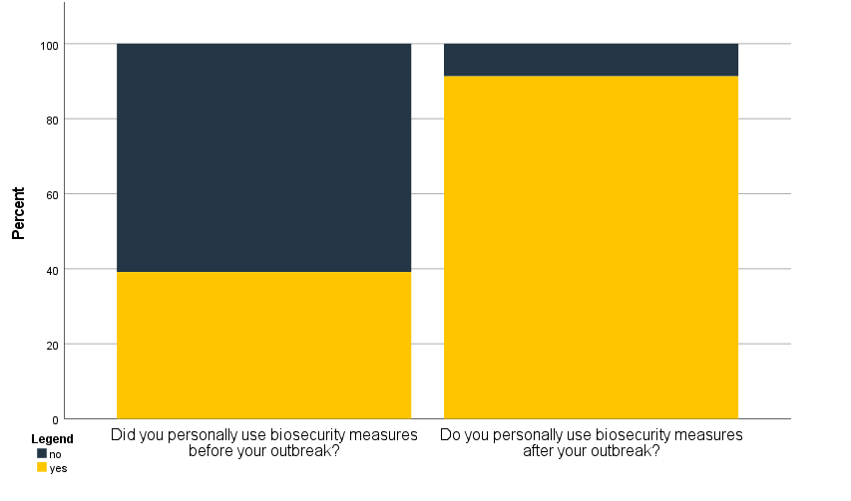

Does an outbreak change our behaviour?
UK Horse owner survey:
After experiencing a Strangles outbreak there was a 52% increase in the use of personal biosecurity
No
No
Yes
Yes
Research from the Royal Veterinary College funded by The Horse Trust
Notes:
The research undertaken by the Surveillance of Equine Strangles also asked horse and yard owners that had been affected by a strangles outbreak between 2020 and 2022 about their use of personal biosecurity measures before and after their outbreak.
Biosecurity measures implemented by respondents included: Regular hand washing or sanitising, only handling/touching required horses on the premises, use of foot dips and regularly disinfecting boots, wearing coveralls or changing clothes between premises.
What can we take away from this? Don’t wait to act! Start implementing biosecurity measures now and routinely to keep your horse and yard safe. Even just one change in habit such as using hand sanitizer between horses could make a big impact.
(An exact McNemar's test determined that there was a statistically significant difference in the proportion of horse owners implementing measures pre- and post-outbreak, p=0.02.)

Slide 31
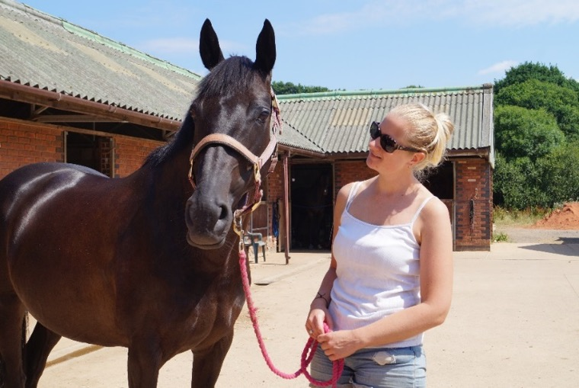

Why wait for an outbreak?
“There is increased demand from horse owners for yards and their staff to have an active part in ensuring the health and welfare of their horses. It is encouraging to see so many yards insisting on isolation and screening for new arrivals, giving horse owners confidence that prevention or an outbreak will be managed well and openly communicated.”
Cheryl Johns,
Company Director, Livery List
Photo credit: Redwings Horse Sanctuary
“If I were to leave and look at other yards, one of the first questions I would ask would be what their Strangles quarantine procedure is”
Jemima, Horse Owner, Exeter

Slide 32
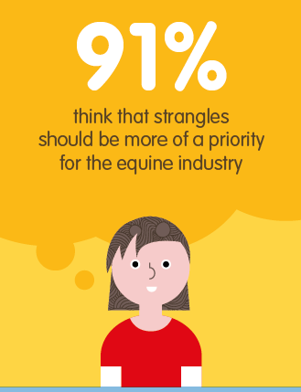
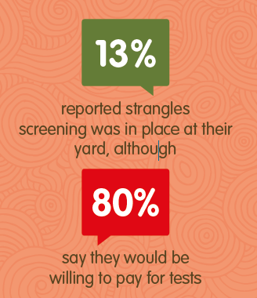
Screening and quarantine is in demand!
Redwings Strangles survey found that:
70% of owners are able to quarantine their horse if they want or need to
Lack of knowledge and stigma were seen as greater barriers to Strangles prevention than cost
Notes:
Redwings Strangles survey was run in 2016 and completed by more than 2,000 horse owners across the UK. The results show that people do worry about Strangles and want to do more to protect horses from it.
It also showed that the desire for change isn’t yet reflected in the norms we see in the equestrian community.
The Stamp Out Strangles campaign wants to galavanise the intention to do more to tackle Strangles, give people information and practical ideas, and encourage them to work with their vet – who will be able to show them that protecting horses is probably easier than they think!

Slide 33
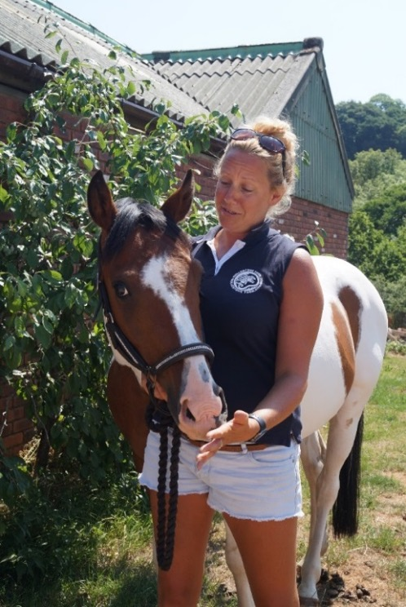
Yards can stay a step ahead
“We are one of the biggest yards in the area, with 50 horses here at any one time, so the logistics of an outbreak would be dire, not to mention the huge veterinary costs involved, and the lockdown meaning no competitions, fun rides, hacking or clinics to aim for and enjoy.
We introduced a quarantine and blood screening policy that we have now had in place for two and a half years
We have not found this impacts at all on our business, other than in a positive way, as our liveries appreciate the efforts taken to help keep their horses safe from Strangles.”
Sarah, Livery Yard Manager, Exeter
Photo credit: Redwings Horse Sanctuary
Notes:
Sarah has taken the Stamp Out Strangles Yard Manager pledge.
The yard has well-established screening and biosecurity practices of a high standard and demonstrate how taking a proactive approach is not only possible and practical for a successful business, but actually enhances their reputation and sets standards in the local area.

Slide 34
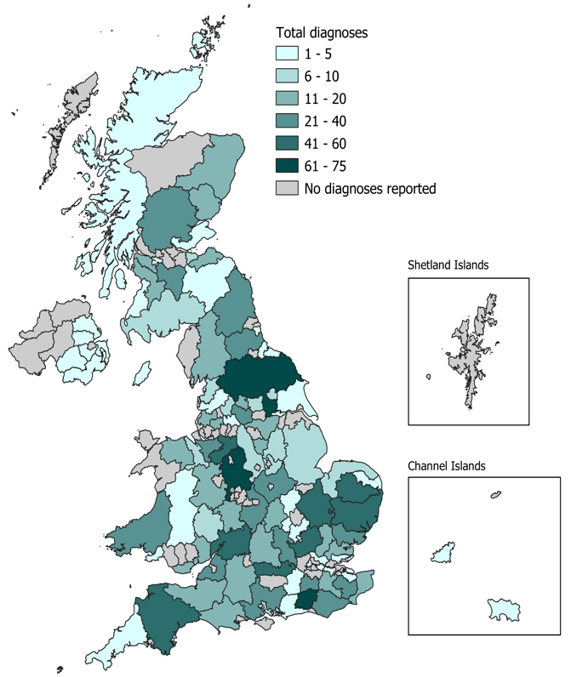
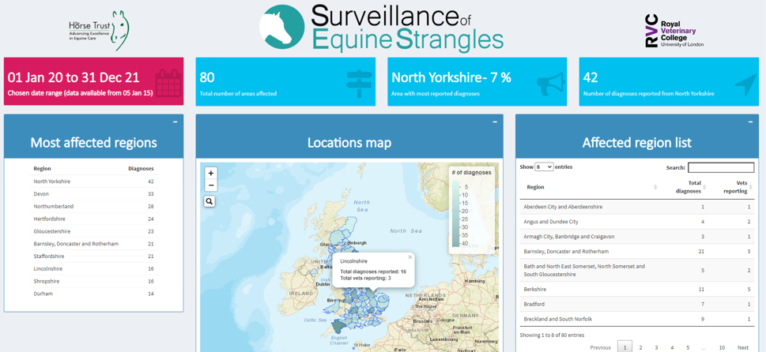
Tracking UK outbreaks
www.jdata.co.za/ses
Up to date reports on laboratory confirmed Strangles diagnoses
Check the map before you travel to different regions
See what clinical signs are being most frequently reported
Notes:
The surveillance of equine strangles network has an online platform which summarises information about laboratory strangles diagnoses reported to the network. Data goes back to 2015 and is reported to the most recent sampling date available.
Using the link on the screen you can be actively aware of strangles diagnoses across the UK and assess the potential risk to your horse(s) if you’re travelling around the UK. This simple tool can help you increase your awareness and biosecurity measures through just a few clicks or taps. It’s available on phones, tablets and computers!

Slide 35
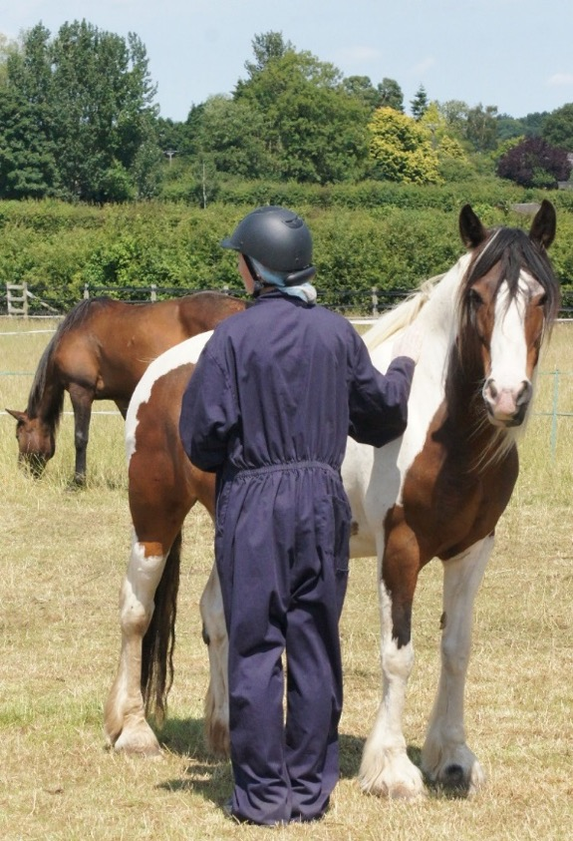
Caution – no guarantees!
  No biosecurity system can be 100%
  – outbreaks can still happen
  BUT routine biosecurity practices also support faster resolution of an outbreak:
  More information on horses’ health history
  Confidence in lack of carriers on site
  Familiarity with setting up and using quarantine
  Knowledge of testing and monitoring for Strangles
Photo credit: Redwings Horse Sanctuary

Slide 36

Strangles can happen to anyone
Notes:
**video autostarts**
A two-minute film showing how Redwings successfully managed its only Strangles outbreak in 23 years of operating a screening programme – during which time it has brought many hundreds of rescued horses into its care from all over the UK
As the film shows, although Redwings have a gold standard screening programme for all new horses, they didn’t assume a horse with signs of infectious disease could not have Strangles – no system can be 100% effective

Slide 37
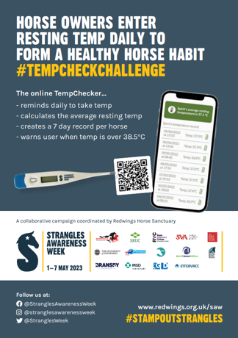

One simple step: check your horse’s temperature!
The normal equine rectal temperature range is between 36.0 – 38.0°c (Hall et al. 2018)
A temperature of 38.5°c or above is classed as fever
Most horses with Strangles develop fever 2-3 days before they become infectious #HotBeforeSnot!
Learn how to take rectal temperatures – check out Piggy March’s video…
Encourage anyone who keeps horses to take temperatures routinely. Don’t wait for a sick horse!
Use the Temp Check Challenge to make a habit of checking in with your horse’s health
Notes:
One of the simplest, quickest and cheapest ways we can stop Strangles in its tracks is to monitor our horses’ temperatures.
Research shows that fever is almost always the first sign of Strangles or other infectious disease such as Equine Flu or Equine Herpes Virus. Fever also emerges around two to three days BEFORE other signs of disease such as nasal discharge or swollen lymph nodes which is associated with shedding bacteria and passing the disease to other horses.
This means that spotting fever and taking precautions is our golden opportunity to contain the disease and could be the difference between one infected horse and a whole yard. All for the price of a thermometer!
Regular temperature monitoring also means we get to know what is normal for one horse, and what is not. As you can see, the average range of a healthy horse can differ by up to two degrees centigrade. A temperature of 37.6 degrees may be usual for one horse, but suggest a potential issue in a horse whose normal reading is 36.4 degrees.

Slide 38

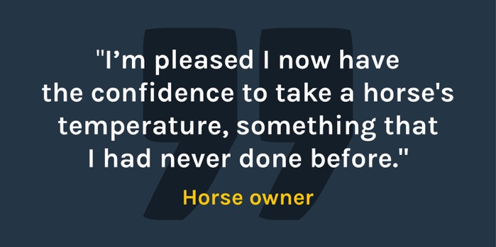

The #TempCheckChallenge
Enter readings into the free online Temp Checker at www.redwings.org.uk/tempchecker
Your horse’s average will be automatically calculated!
Everyone who enters at least three readings between 1st and 13th May 2023 will be entered into a prize draw…
The winner receives a guided tour of Piggy March’s yard!
Notes:
Most of us know we should check our horse’s temperatures, but only remember to do it when we think our horse may be unwell. As we’ve learned, in cases of Strangles this is often too late to have stopped the disease already spreading.
To help owners and horses get into the swing of regular temp checking, Strangles Awareness Week is running the Temp Check Challenge.
All you have to do is take the temperature of your horse every day in the first week of May (or a minimum of 3 times during the week) and upload temperatures into the free online temp checker. The checker will calculate the average temperature and deliver you a notification to remind you to take temperatures and spot a misreading if its too low, or to check again with precautionary quarantine measures in place if 38.5 degrees or above.
As entries are uploaded the checker calculates the horse’s average resting rectal temperature and the challenge has already helped to build the confidence of horse owners who have taken part.
It’s the perfect opportunity to get to know your horse’s normal and a great way to support the week – especially if you take up the challenge with a friend or even across your whole yard!
If you know your horse’s normal temperature please post it in support of @StranglesAwarenessWeek and encourage others to get to know their horse’s normal too. The more people who routinely check rectal temperatures and have better insight into their horse’s health, the easier it is to spot infection early and stop outbreaks in their tracks!

Slide 39
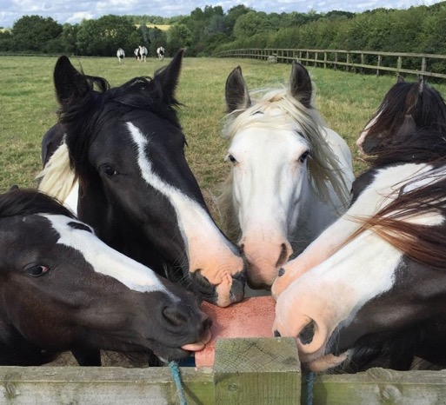
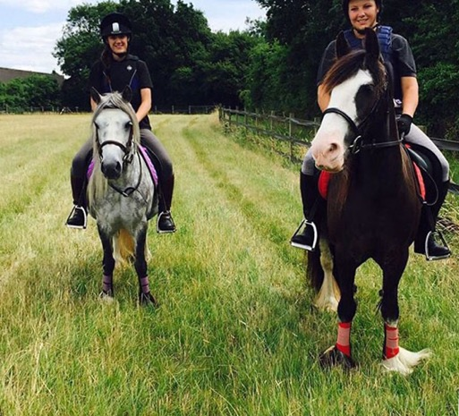
Turn your knowledge into action!
Don’t wait for an outbreak – be proactive!
Take part in the Temp Check Challenge!
Monitor your horse’s temperature routinely – especially after events
Ask your vet about screening and biosecurity
Keep disinfectant and isolation equipment in stock
Be open and supportive if an outbreak occurs
Follow us on Facebook: @StranglesAwarenessWeek
Twitter: @StranglesWeek
Instagram: @stranglesawarenessweek
Become a Strangles Awareness Week Ambassador for free at www.redwings.co.uk/strangles/strangles-awareness-week
Photo credits: Redwings Horse Sanctuary

Slide 40
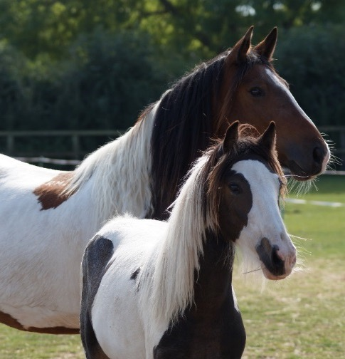

Thanks for listening!
Any questions?
Photo credit: Redwings Horse Sanctuary
Notes:
This is a picture of Dancer, the foal in the first slide (with Andrew Waller’s quote) after her recovery from a complex case of Strangles which meant she was quarantined with her mother, Frenchie, for more than six months. Frenchie also tested positive on arrival at Redwings, but was in the recovery phase of the disease.

Slide 41
References:
Strangles: Speak Out 2nd ed. (2018) www.redwings.org.uk/Strangles
Redwings Horse Sanctuary (2017) Strangles Survey Results: Main report exploring horse-owner knowledge, attitudes and practices around the prevention of Strangles
Redwings Horse Sanctuary (2016) Treatment protocol for Strangles carriers
Boyle. A.G. et al. (2018) Streptococcus equi Infections in Horses: Guidelines for Treatment, Control, and Prevention of Strangles—Revised Consensus Statement. Journal of Veterinary Internal Medicine
https://www.vettimes.co.uk/article/Strangles-eradication-hopes/?format=pdf
Robinson C et al. Strangvac: A recombinant fusion protein vaccine that protects against Strangles, caused by Streptococcus equi. Vaccine (2018), https://doi.org/10.1016/j.vaccine.2018.01.030
Waller, AS.(2016) Strangles: a pathogenic legacy of the war horse Veterinary Record 178, 91-92
Yarnell, K. et al. (2017), Reducing exposure to pathogens in the horse: a preliminary study into the survival of bacteria on a range of equine bedding types. Journal of Applied Microbiology, 122: 23-29
AHT/BEVA/DEFRA Equine Quarterly Disease Surveillance Report vol.13, No.4 Oct-Dec 2017
Durham et al (2018) A study of the environmental survival of Streptococcus equi subspecies equi. Equine Veterinary Journal 03.03.18
Newton, J.R. et al. (1998) ‘Detection and treatment of asymptomatic carriers of Streptococcus equi following Strangles outbreaks in the UK’, in Equine Infectious Diseases VIII, Dubai
Verheyen, K. et al. (2000) ‘Elimination of guttural pouch infection and inflammation in asymptomatic carriers of Streptococcus equi’, Equine Veterinary Journal, 32(6), 527–532
McGlennon, A., Waller, A., Verheyen, K., Slater, J., Grewar, J., Aanensen, D. and Newton, R. (2021) Surveillance of Strangles in UK horses between 2015 and 2019 based on laboratory detection of Streptococcus equi. Vet. Rec. 1–9. https://onlinelibrary.wiley.com/doi/10.1002/vetr.948
Rendle, D., de Brauwere, N., Hallowell, G., Ivens, P., McGlennon, A., Newton, R., White, J. and Waller, A. (2021) Streptococcus equi infections: current best practice in the diagnosis and management of ‘Strangles.’ UK-Vet Equine 5, S3–S15. http://www.magonlinelibrary.com/doi/10.12968/ukve.2021.5.2.S.3.
Houben, R. M. A. C., van Maanen, K., Kemp‐Symonds, J. G., Waller, A. S., Sloet van Oldruitenborgh‐Oosterbaan, M. M., & Heesterbeek, H. (2022). Estimation of the basic reproduction number for Streptococcus equi spp. equi outbreaks by meta‐analysis of strangles outbreak reports. Equine Veterinary Journal. https://doi.org/10.1111/evj.13865

