Slide 1
Writing for
Social Justice
Learning about the impact disability
had on Anna’s life and animal welfare

Slide 2
Social Justice:
Disability

Slide 3
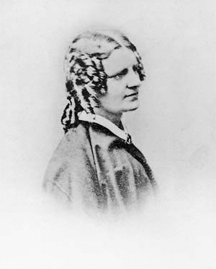

Anna Sewell’s life was profoundly shaped and influenced by her disability. Because she struggled to walk for long periods, she needed to find other ways to get around. She turned to horses, and grew close to them (and they to her) because she relied on them so much. She relied on horses to get her from place to place, and her gentle understanding of horses’ ways meant she was able to travel independently – she often took the reins herself. A close family friend described Anna’s use of horses as kind and friendly: ‘Anna seemed simply to hold the reins in her hand, trusting her voice to give all needed directions to her horse.’

Slide 4
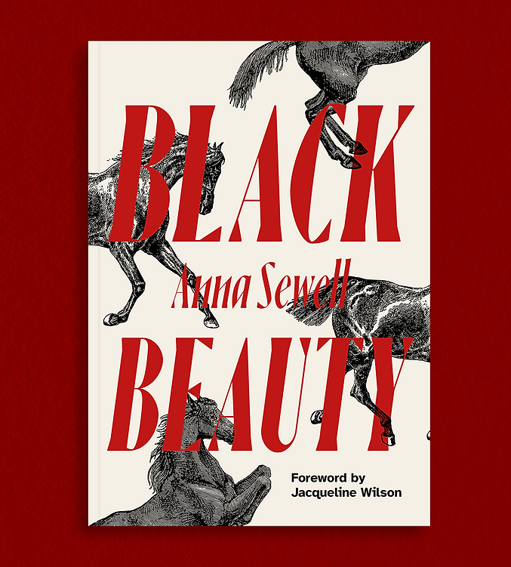
Even towards the end of her life, when illness kept her inside, a horse gave her a goal and a purpose: her closeness and understanding led her to dream up Black Beauty and write the book that made her famous. Black Beauty could only have been written by someone as in-tune with horses as Anna was, and by someone with a profound insight into both the beauty and suffering of the world around her.

Slide 5
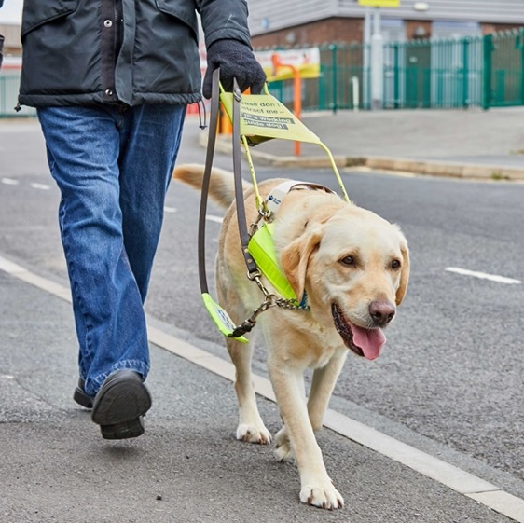

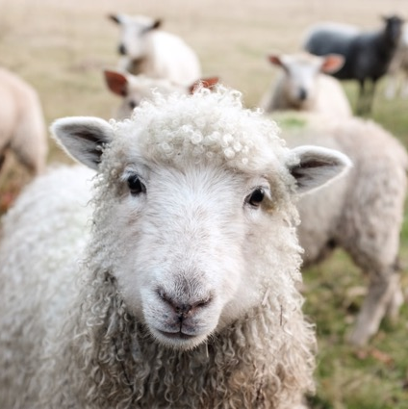
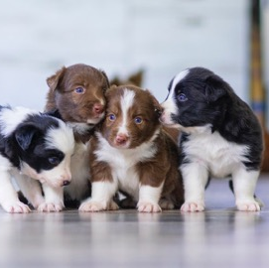
Though we don’t use horses in this way anymore, they were clearly very important for Anna’s health and happiness. Today, animals still help people. There are guide dogs and hearing dogs, companion animals for the elderly, emotional support dogs. Animals can even be trained to detect allergens in food. Sheep visit schools, puppies visit university libraries, and people have pets and service animals to make their lives happier and healthier.

Slide 6
Activity

Slide 7
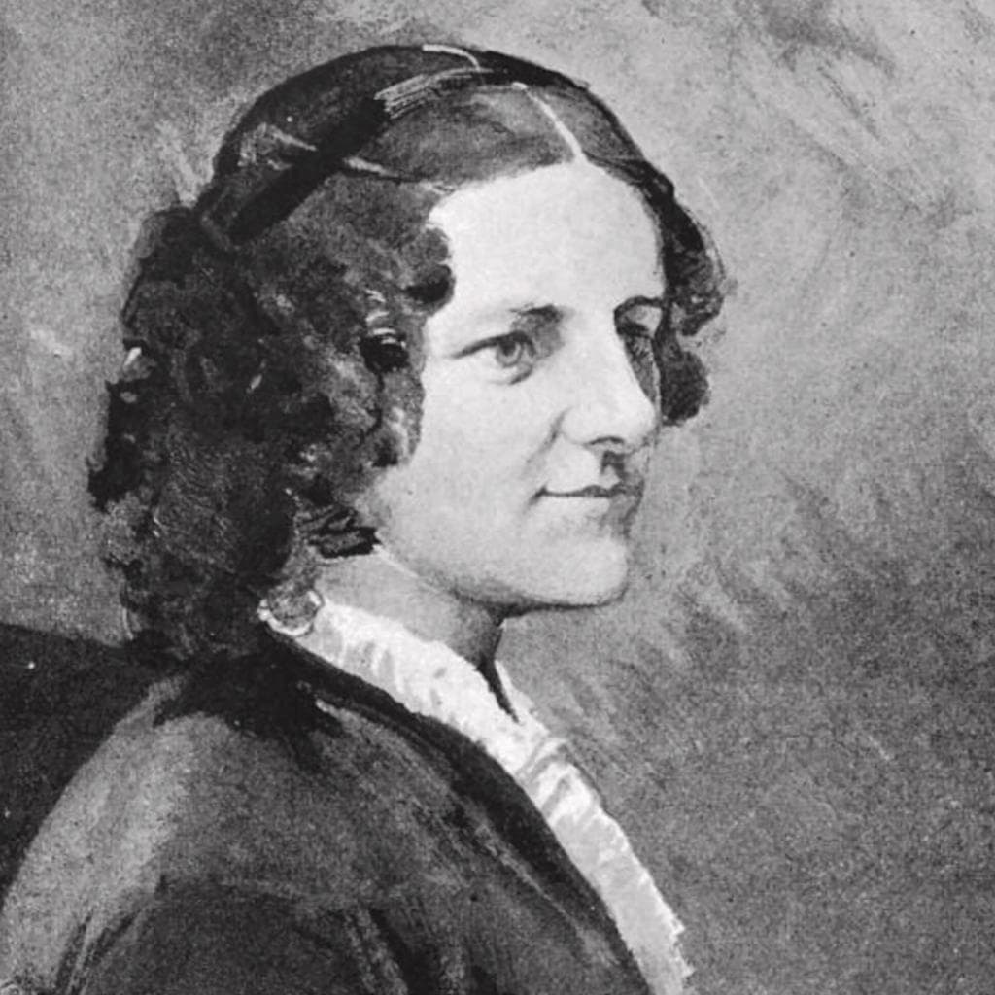
What is something that gives or has given you a unique perspective on the world around you? What story could that perspective help you tell?
Spend 5 minutes writing a short version of that story – try not to edit as you go along, just put your pen to paper and see what comes out (this is called Free Writing).

Slide 8
Social Justice:
Animal Welfare

Slide 9
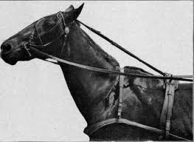
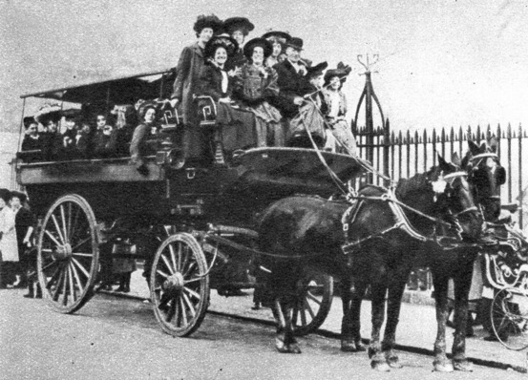
One of the biggest impacts of Black Beauty was the way it changed horses’ lives for the better. Horses in the Victorian era were often put into something called a “bearing rein,” which held their heads up tall while they walked. People thought this made the horses look very handsome and proud, but it was extremely uncomfortable for the horses to wear. Anna Sewell hated bearing reins, and, as part of her goal to “induce kindness” towards working horses, she wrote a chapter in which Black Beauty describes how horrible it is to wear this kind of rein.

Slide 10
Because it was written in the voice of a horse, Black Beauty was a useful book for animal rights campaigners. It didn’t just
tell people that bearing reins were bad,
it showed them why. By appealing to the readers’ emotions, Anna Sewell was able
to make a real difference in horses’ lives.
Anna died before she could truly see the impact her book had made, but even in death she was changing horses’ circumstances – a friend of her family recalls Anna’s mother requesting the bearing reins be taken off the horses pulling the hearse at Anna’s funeral.

Slide 11
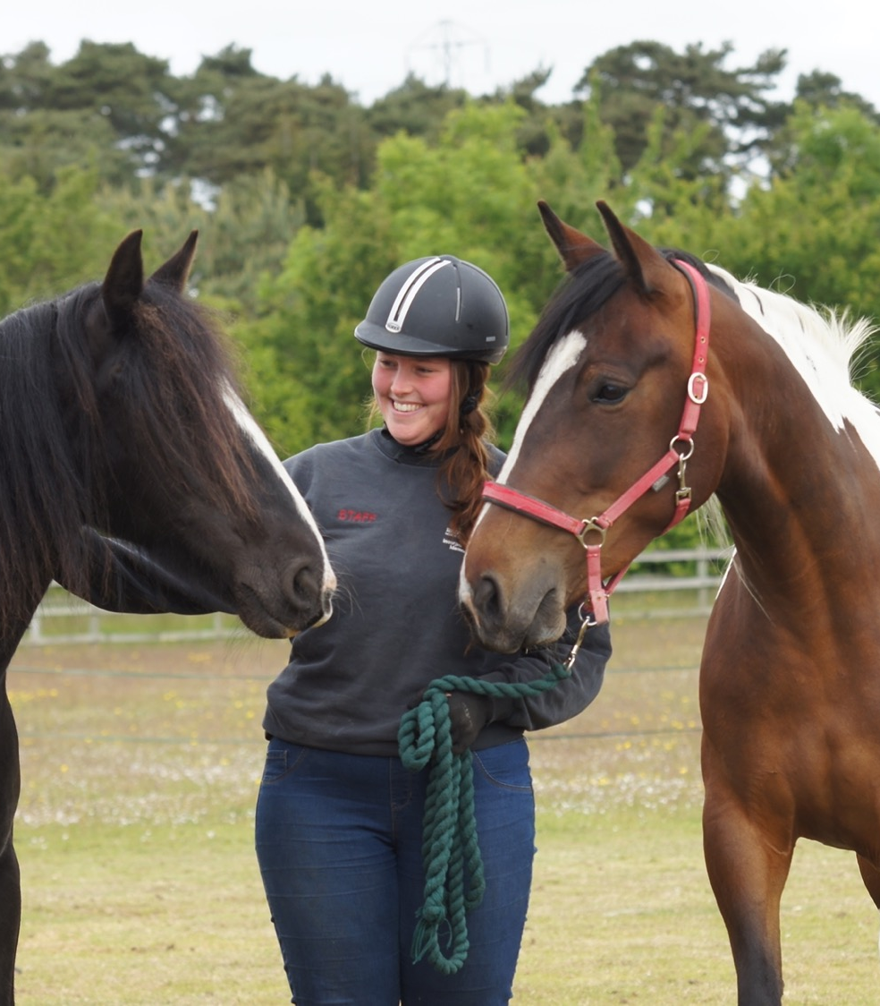
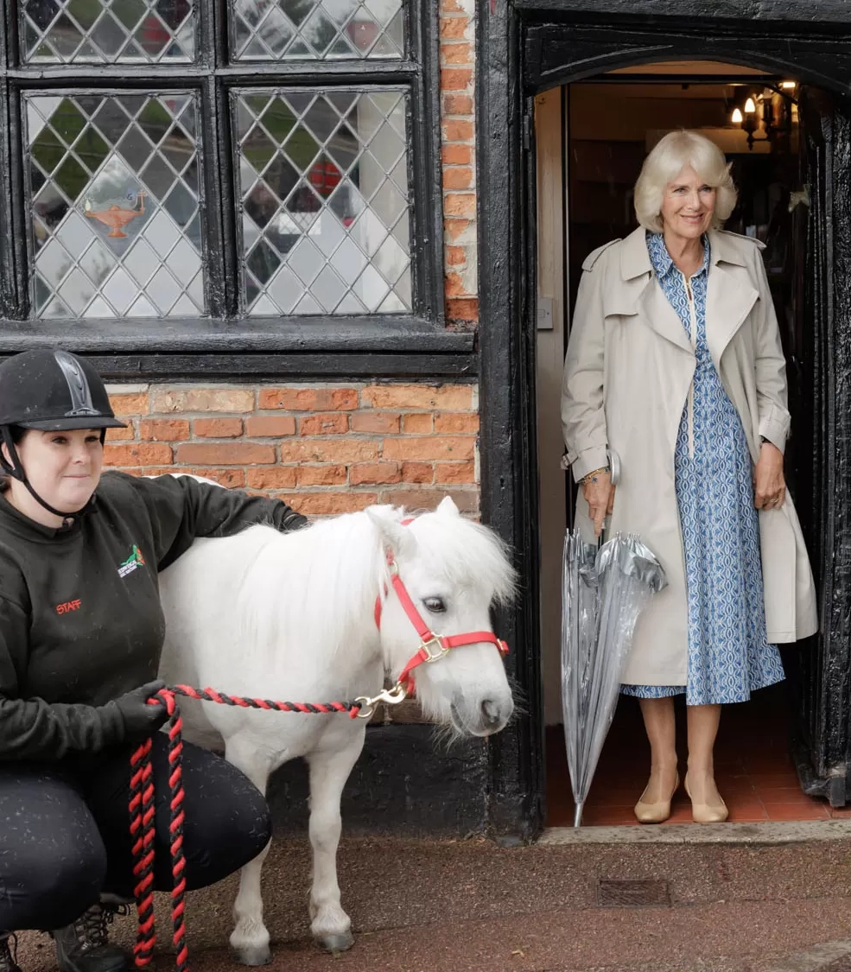
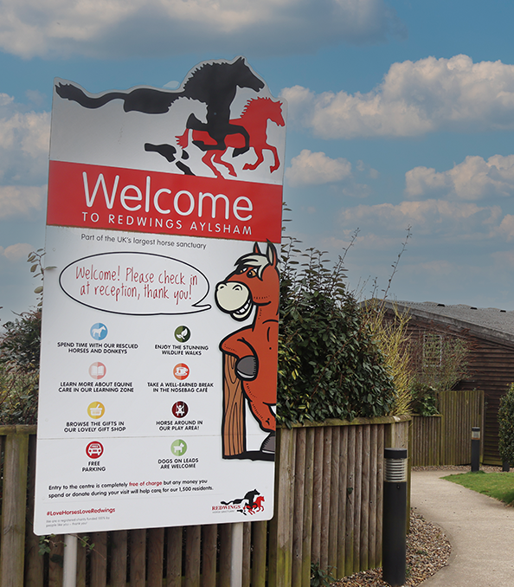
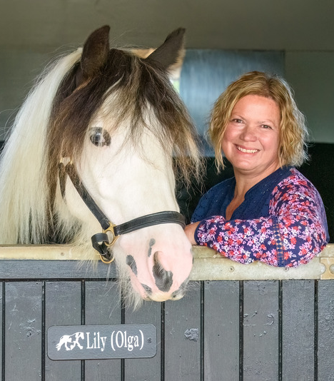
Black Beauty is still having a positive influence: Redwings Horse Sanctuary carries on the book’s legacy every day, as it treats horses with kindness, gives them a safe place to spend their lives, and campaigns for horse welfare.

Slide 12
Activity

Slide 13

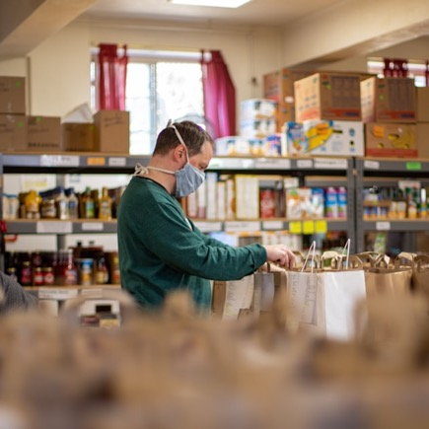
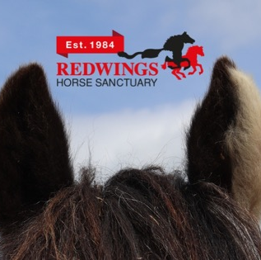
Think of a cause you are passionate about – it could be animal rights, climate change, gender equality, or accessibility – and think about how you might tell a story that appeals to your readers’ emotions.

