Slide 1
Norfolk
Learning more about where Anna Sewell
was born and spent much of her life

Slide 2
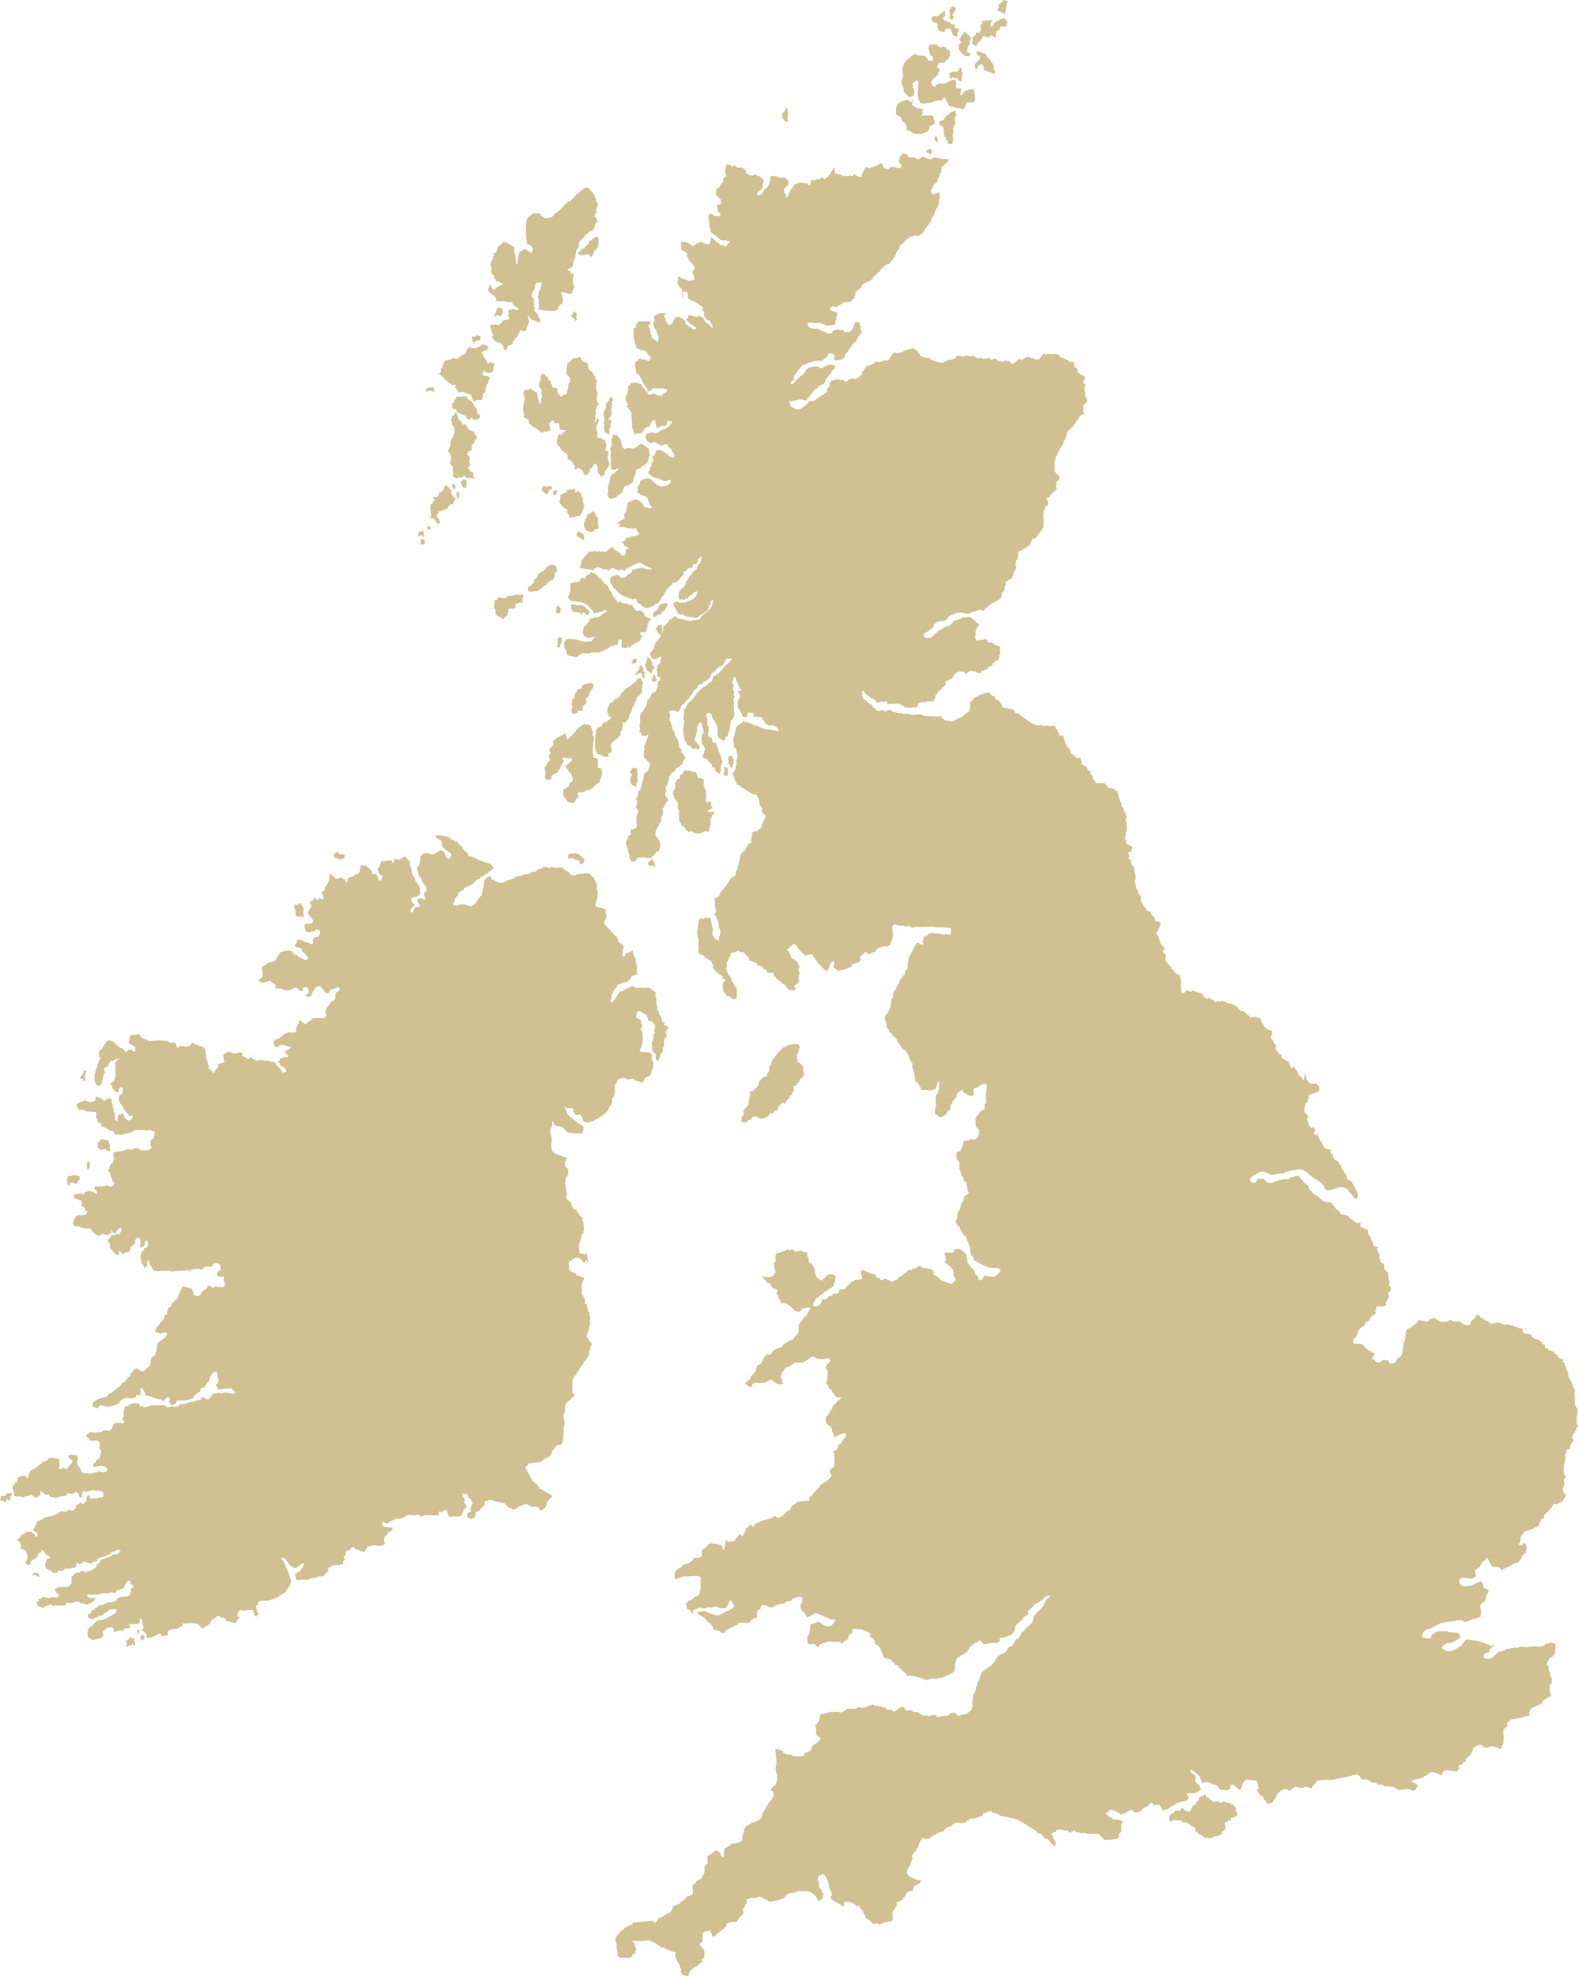
Anna Sewell was born in Norfolk, and spent much of her life here. Here are a few places throughout the county that have some link to Anna and her family.
Norfolk

Slide 3
Wells-next-the-Sea
Cromer
Great Yarmouth
The house where Anna was born still stands, on Church Plain. Today, the house is a memorial to Anna and her work to better horses’ welfare. It is looked after by Redwings Horse Sanctuary, who continue Anna’s legacy of kindness and care.
Anna’s parents were Quakers, a Protestant Christian sect defined by their pacifism and a doctrine of “inward light” – the idea that God is present within everyone. Anna’s Quaker beliefs, particularly in kindness to fellow creatures, heavily influenced her writing of Black Beauty.
Kings Lynn
Great Yarmouth
Swaffham
Wymondham
Thetford
Diss

Slide 4
Wells-next-the-Sea
Cromer
Buxton
Anna spent lots of time during her childhood
at Dudwick Farm near Buxton, where her grandparents lived. It was here that she learnt to ride horses, and this place is thought to have inspired ‘Bertwick Park,’ the place in Black Beauty where Beauty gets his first job, and where he meets his friends Merrylegs and Ginger.
Kings Lynn
Buxton
Great Yarmouth
Swaffham
Wymondham
Thetford
Diss

Slide 5
Wells-next-the-Sea
Cromer
Buxton
“One of the great delights of their early days, and many later ones, was a visit to Buxton. Buxton was the Paradise of children – there they found the joy of unfettered freedom in the country; and, besides aunts and grandmother, there was the grandfather, the central attraction to all the grandchildren. When he was sitting, they were sure to be round him; when he walked, they were by his side. There was never any noise or boisterous play, but anyone who watched could see that the conversation was full of deep interest.”
(Mary Sewell, Autobiography, p. 59)
Kings Lynn
Buxton
Great Yarmouth
Swaffham
Wymondham
Thetford
Diss

Slide 6
Wells-next-the-Sea
Cromer
Buxton
Anna was buried in the Quaker burial ground
in Lamas. Her mother wrote after her death, “she was laid in the little, quiet burying ground where her ancestors for many generations sleep undisturbed. It is in the village next to Buxton, where my sisters live, and belongs to the Friends, who were numerous in those parts. It is a sequestered spot, surrounded by trees and a high hawthorn hedge, where the birds are never disturbed.” (Mary Sewell, Autobiography, p. 285). Anna’s gravestone can still be seen in Buxton with Lamas today.
Kings Lynn
Buxton
Great Yarmouth
Swaffham
Wymondham
Thetford
Diss

Slide 7
Wells-next-the-Sea
Old Catton
After moving around a lot, the Sewell family moved back to Norfolk. They settled in Old Catton in 1867, when Anna was 47. She had been in ill health since childhood, and remained close to her mother. She was confined to her bed for the last years of her life, and relied on her mother to bring the outside world to her, to keep her company, and to write down the story that Anna told from her bed – which was to become Black Beauty.
Mary Sewell was an accomplished poet, and spent lots of time caring for the wellbeing of her neighbours. There is a blue plaque dedicated to her on the wall opposite St. Margaret’s Church in Old Catton.
Cromer
Kings Lynn
Buxton
Old Catton
Great Yarmouth
Swaffham
Wymondham
Thetford
Diss

Slide 8
Wells-next-the-Sea
Cromer
Norwich
Just into the city from Old Catton, the Sewell name crops up, marking land that was once owned by Anna’s brother Philip. There is Sewell Park, which houses a sign with the silhouette of a black horse, and Sewell Barn Theatre, which was once a barn that housed a horse which might have been the real-life inspiration for Black Beauty himself. There is a horse trough outside the park which acts as a memorial for Anna Sewell and reminds 21st century park-goers of her important work.
Kings Lynn
Buxton
Old Catton
Great Yarmouth
Swaffham
Norwich
Wymondham
Thetford
Diss

Slide 9
Activity

Slide 10

People and places
Think of a place that’s important to you – it might be your home, or your school, a family member or friend’s house, maybe it’s the local park or your favourite beach. What does this place say about you? Write a list of things someone might learn about you from visiting that place.
You can extend this activity into a poem by writing
two lists: one list of sentences about the place, and one list of sentences about you. For example:
The park has views over the whole city
The park is where dogs play fetch
The park turns orange in the Autumn
Anna writes stories
Anna has brown hair and gentle eyes
Anna loves horses

Slide 11
People and places
When you’re finished, cross out the place name and write your name in its place. Like this:
These sentences don’t make literal sense, but do they work as metaphors? What surprising metaphors have you created in your version?
The park Anna has views over the whole city
The park Anna is where dogs play fetch
The park Anna turns orange in the Autumn
Anna The park writes stories
Anna The park has brown hair and gentle eyes
Anna The park loves horses

